Slide 1
Functions
©1992-2017 by Pearson Education, Inc. All Rights Reserved.

Slide 2
Opening Problem
Find the sum of integers from 1 to 10, from 20 to 30, and from 35 to 45, respectively.

Slide 3
Problem
int sum = 0;
for (int i = 1; i <= 10; i++)
sum += i;
cout << "Sum from 1 to 10 is " << sum;
sum = 0;
for (int i = 20; i <= 30; i++)
sum += i;
cout << "Sum from 20 to 30 is " << sum;
sum = 0;
for (int i = 35; i <= 45; i++)
sum += i;
cout << "Sum from 35 to 45 is " << sum;

Slide 4
Problem
int sum = 0;
for (int i = 1; i <= 10; i++)
sum += i;
cout << "Sum from 1 to 10 is " << sum;
sum = 0;
for (int i = 20; i <= 30; i++)
sum += i;
cout << "Sum from 20 to 30 is " << sum;
sum = 0;
for (int i = 35; i <= 45; i++)
sum += i;
cout << "Sum from 35 to 45 is " << sum;

Slide 5
Solution
int sum(int i1, int i2) {
int sum = 0;
for (int i = i1; i <= i2; i++)
sum += i;
return sum;
}
int main() {
cout << sum(1, 10);
cout << sum(20, 30);
cout << sum(35, 45);
}

Slide 6
6.1 Introduction
Develop and maintain a large program by constructing it from small, simple pieces, or components.
divide and conquer.
Emphasize how to declare and use functions to facilitate the design, implementation, operation and maintenance of large programs.
Function prototypes and how the compiler uses them to convert the type of an argument in a function call to the type specified in a function’s parameter list, if necessary.
Simulation techniques with random number generation.
C++’s scope rules.
©1992-2017 by Pearson Education, Inc. All Rights Reserved.

Slide 7
6.1 Introduction (cont.)
How C++ keeps track of which function is currently executing, how parameters and other local variables of functions are maintained in memory and how a function knows where to return after it completes execution.
Function overloading.
Function templates.
Recursion.
©1992-2017 by Pearson Education, Inc. All Rights Reserved.

Slide 8
6.2 Program Components in C++
C++ programs are typically written by combining “prepackaged” functions and classes available in the C++ Standard Library with new functions and classes you write.
The C++ Standard Library provides a rich collection of functions.
Functions allow you to modularize a program by separating its tasks into self-contained units.
©1992-2017 by Pearson Education, Inc. All Rights Reserved.

Slide 9
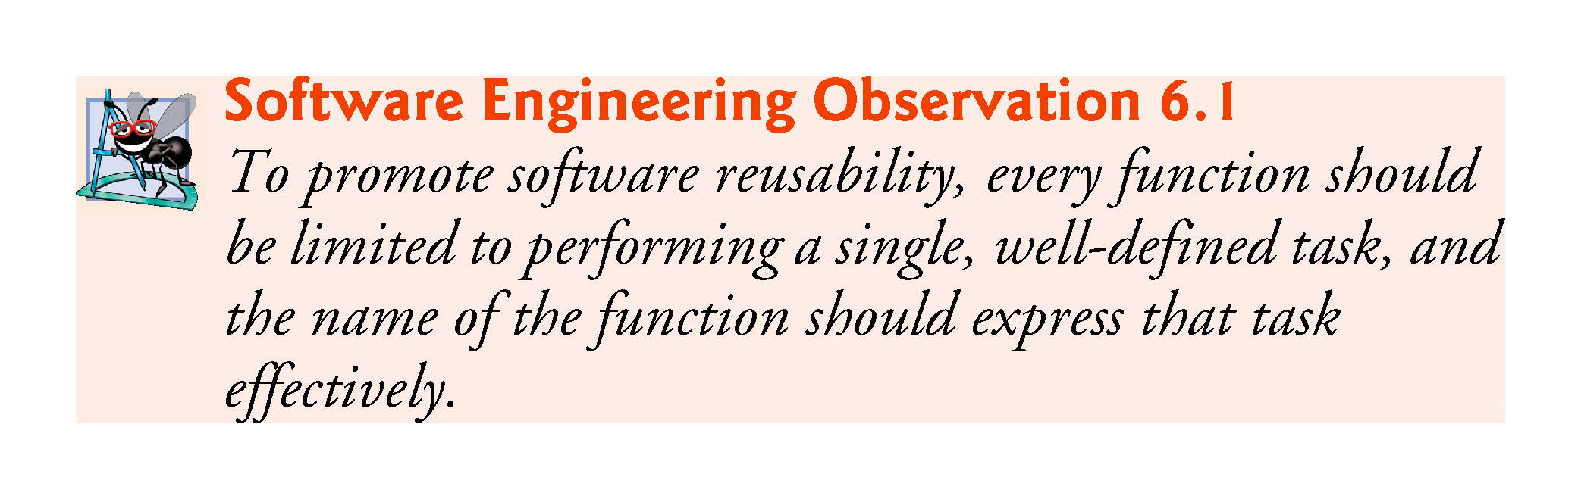
©1992-2017 by Pearson Education, Inc. All Rights Reserved.

Slide 10
6.2 Program Components in C++ (cont.)
A function is invoked by a function call, and when the called function completes its task, it either returns a result or simply returns control to the caller.
An analogy is the hierarchical form of management (Figure 6.1).
A boss (similar to the calling function) asks a worker (similar to the called function) to perform a task and report back (i.e., return) the results after completing the task.
The boss does not know how the worker performs its tasks.
The worker may also call other workers, unbeknownst to the boss.
This hiding of implementation details promotes good software engineering.
©1992-2017 by Pearson Education, Inc. All Rights Reserved.

Slide 11
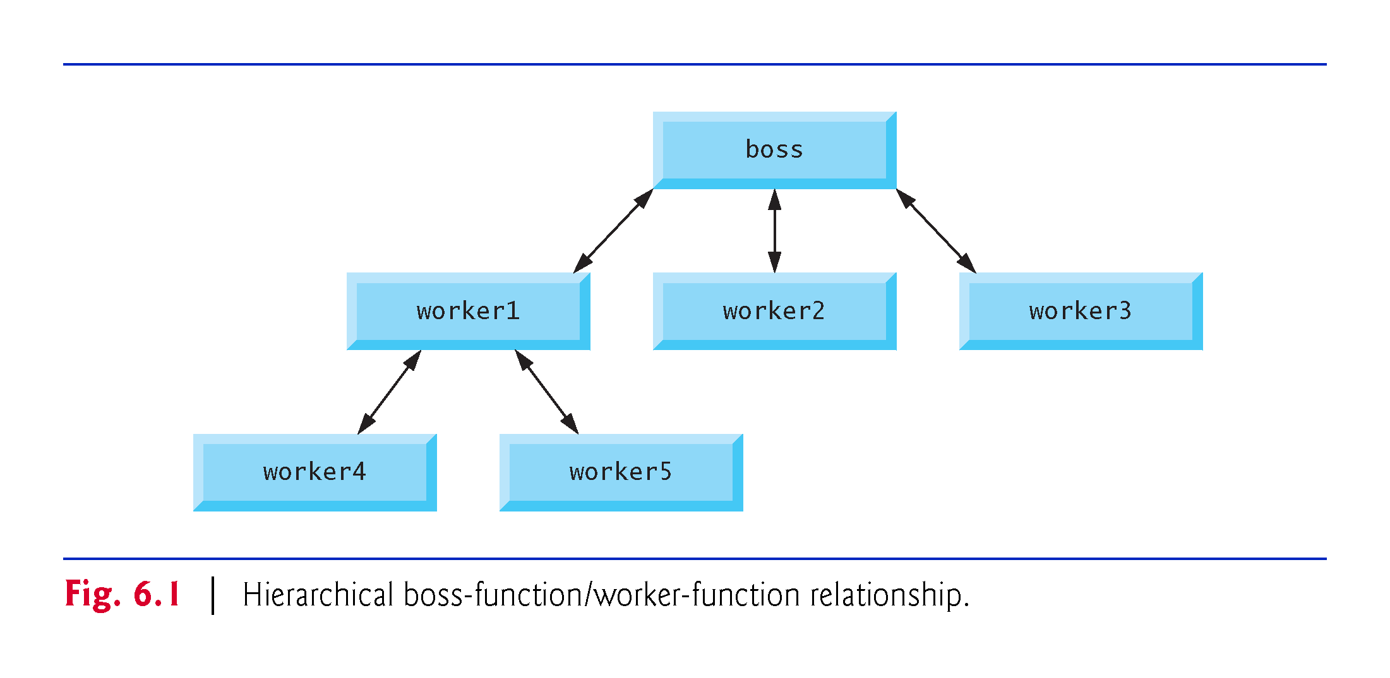
©1992-2017 by Pearson Education, Inc. All Rights Reserved.

Slide 12
6.3 Math Library Functions
Sometimes functions are not members of a class.
Called global functions.
The <cmath> header provides a collection of functions that enable you to perform common mathematical calculations.
All functions in the <cmath> header are global functions—therefore, each is called simply by specifying the name of the function followed by parentheses containing the function’s arguments.
©1992-2017 by Pearson Education, Inc. All Rights Reserved.

Slide 13
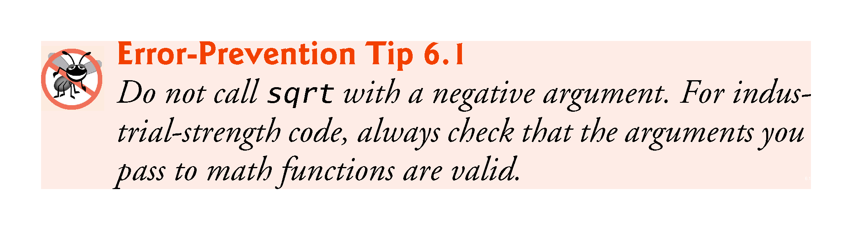
©1992-2017 by Pearson Education, Inc. All Rights Reserved.

Slide 14
6.3 Math Library Functions (cont.)
Some math library functions are summarized in Fig. 6.2.
In the figure, the variables x and y are of type double.
©1992-2017 by Pearson Education, Inc. All Rights Reserved.

Slide 15
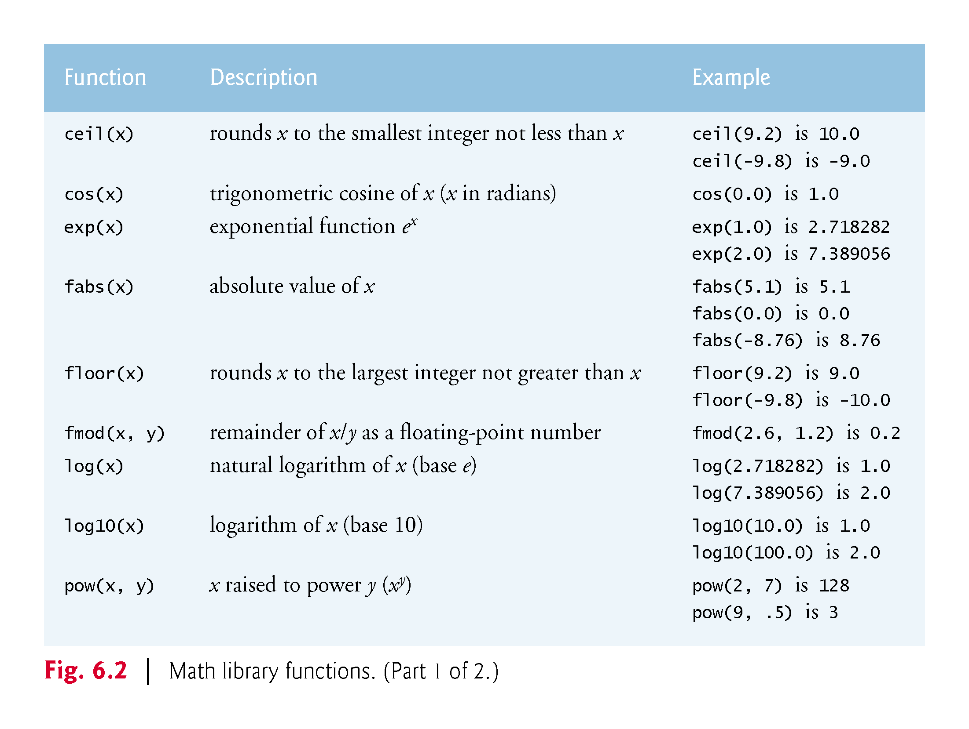
©1992-2017 by Pearson Education, Inc. All Rights Reserved.

Slide 16
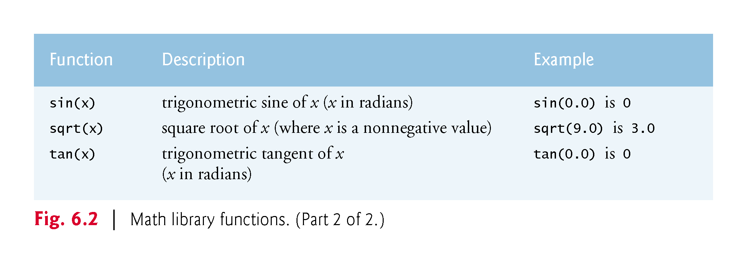
©1992-2017 by Pearson Education, Inc. All Rights Reserved.

Slide 17
6.4 Function Prototypes
In this section, we create a user-defined function called maximum (Fig. 6.3) that returns the largest of its three int arguments.
©1992-2017 by Pearson Education, Inc. All Rights Reserved.

Slide 18
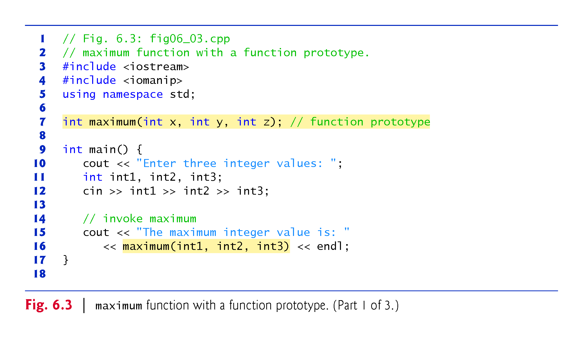
©1992-2017 by Pearson Education, Inc. All Rights Reserved.

Slide 19
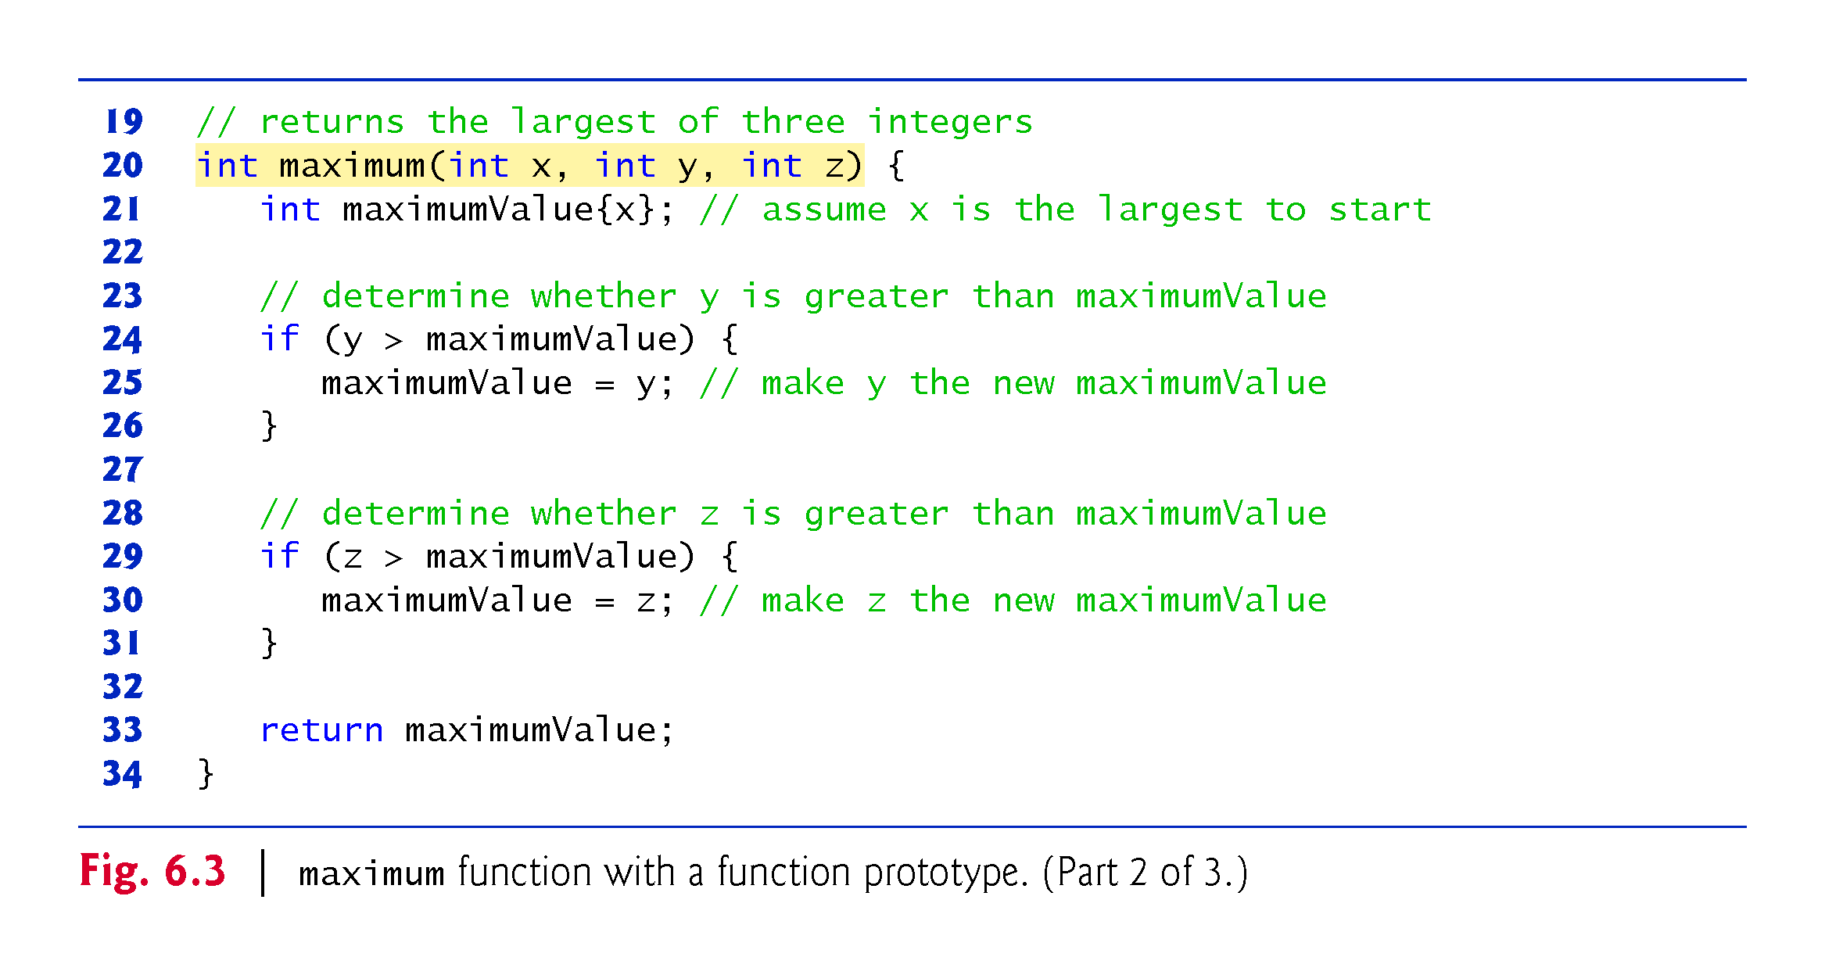
©1992-2017 by Pearson Education, Inc. All Rights Reserved.

Slide 20
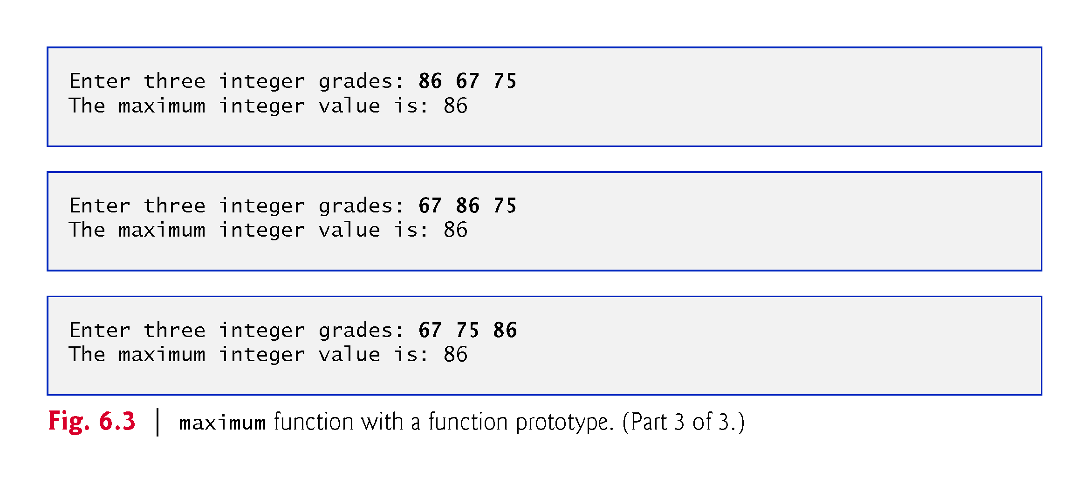
©1992-2017 by Pearson Education, Inc. All Rights Reserved.

Slide 21
Defining Methods
A method is a collection of statements that are grouped together to perform an operation.

Slide 22
6.4 Function Prototypes
A function prototype is a declaration of a function
tells the compiler the function’s name, its return type and the types of its parameters. .
The function prototype is the same as the first line of the corresponding function definition (line 20), but ends with a required semicolon.
©1992-2017 by Pearson Education, Inc. All Rights Reserved.

Slide 23
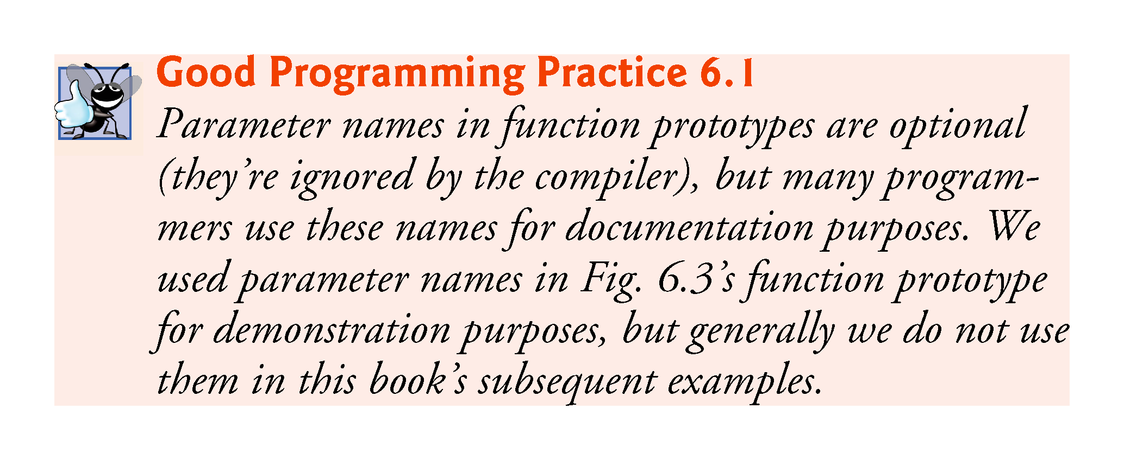
©1992-2017 by Pearson Education, Inc. All Rights Reserved.

Slide 24
6.4 Function Prototypes (cont.)
When compiling the program, the compiler uses the prototype to
Ensure that maximum’s first line matches its prototype.
Check that the call to maximum contains the correct number and types of arguments, and that the types of the arguments are in the correct order.
Ensure that the value returned by the function can be used correctly in the expression that called the function.
Ensure that each argument is consistent with the type of the corresponding parameter.
If the arguments passed to a function do not match the types specified in the function’s prototype, the compiler attempts to convert the arguments to those types.
©1992-2017 by Pearson Education, Inc. All Rights Reserved.

Slide 25
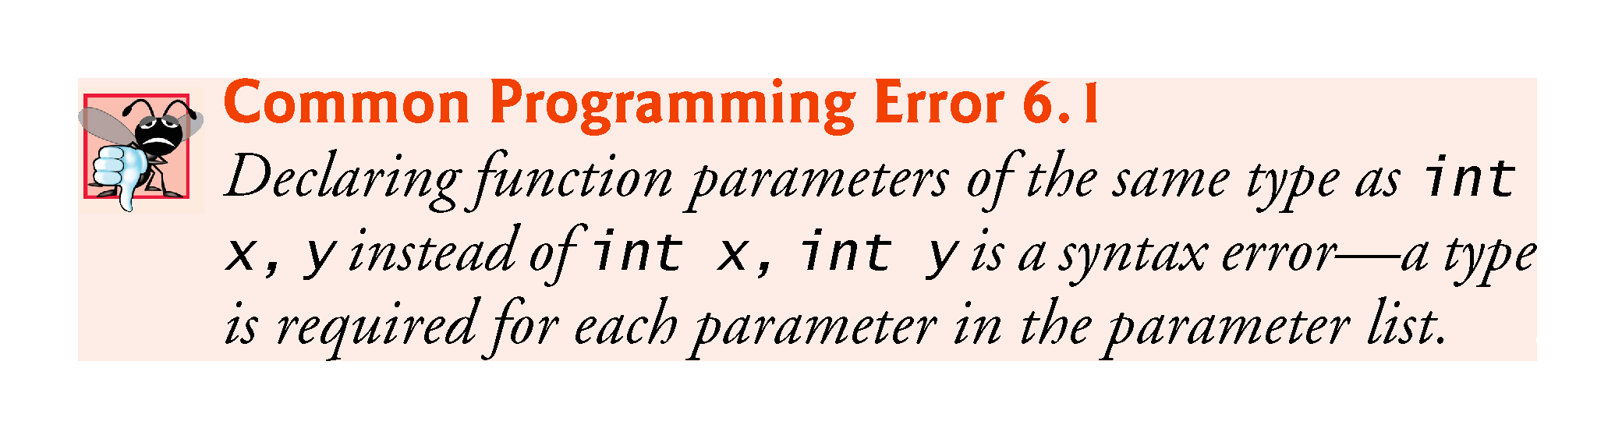
©1992-2017 by Pearson Education, Inc. All Rights Reserved.

Slide 26
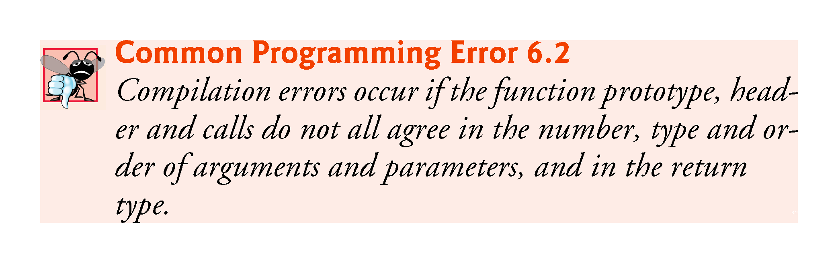
©1992-2017 by Pearson Education, Inc. All Rights Reserved.

Slide 27
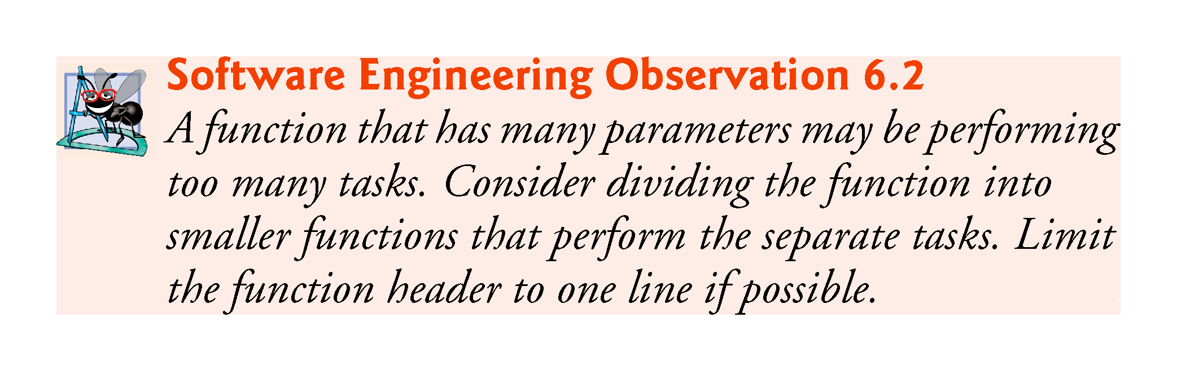
©1992-2017 by Pearson Education, Inc. All Rights Reserved.

Slide 28
6.4 Function Prototypes (cont.)
Multiple parameters are specified in both the function prototype and the function header as a comma-separated list, as are multiple arguments in a function call.
©1992-2017 by Pearson Education, Inc. All Rights Reserved.

Slide 29
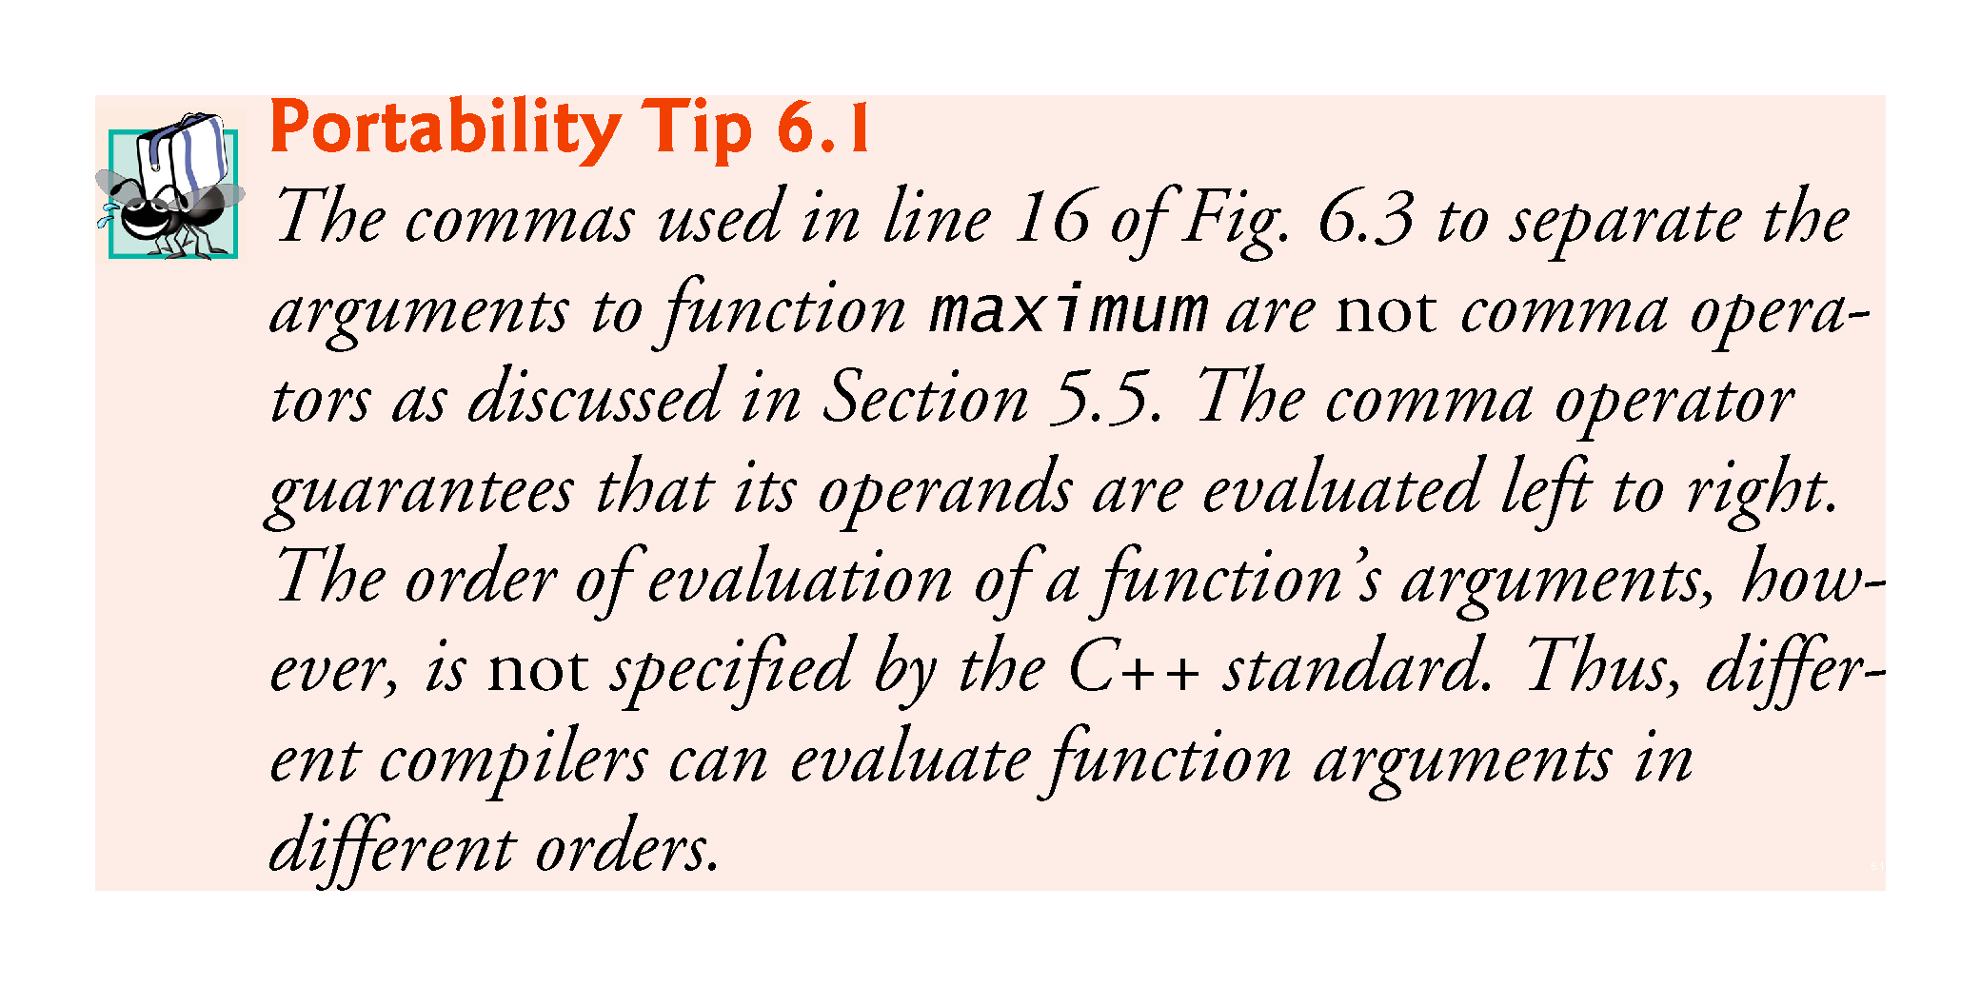
©1992-2017 by Pearson Education, Inc. All Rights Reserved.

Slide 30
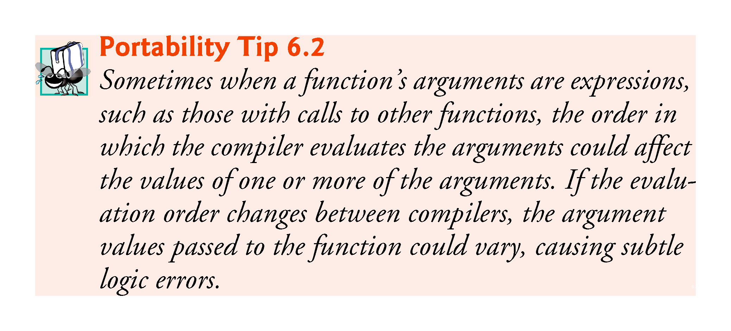
©1992-2017 by Pearson Education, Inc. All Rights Reserved.

Slide 31
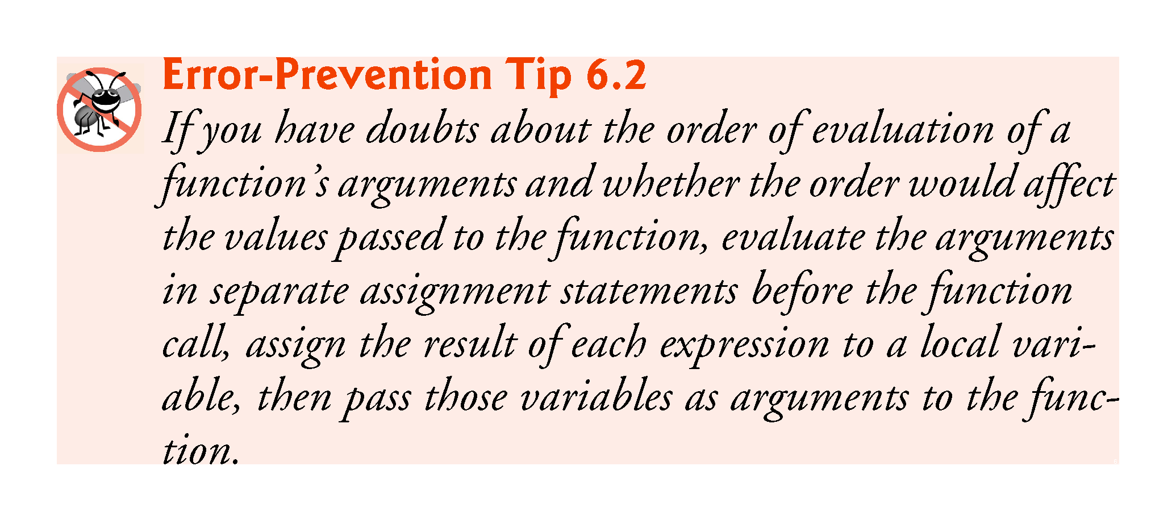
©1992-2017 by Pearson Education, Inc. All Rights Reserved.

Slide 32
6.4 Function Definitions with Multiple Parameters (cont.)
In a function that does not return a result (i.e., it has a void return type), we showed that control returns when the program reaches the function-ending right brace.
You also can explicitly return control to the caller by executing the statement
return;
©1992-2017 by Pearson Education, Inc. All Rights Reserved.

Slide 33
Basic exercises
Write a function “cube” that takes an integer and outputs the cube of the output.
Write a function “power” that takes a double x and an integer pow and outputs x ^{power} (use a for loop, do not use pow).
Write a function “concatenate” with void output that takes two strings and couts one string next to the other (that is, for example, concatenate(foo, yee) will print out fooyee).
©1992-2017 by Pearson Education, Inc. All Rights Reserved.

Slide 34
6.5 Function-Prototypes and Argument-Coercion Notes
A function prototype is required unless the function is defined before it’s used.
When you use a standard library function like sqrt, you do not have access to the function’s definition, therefore it cannot be defined in your code before you call the function.
Instead, you must include its corresponding header (<cmath>), which contains the function’s prototype.
©1992-2017 by Pearson Education, Inc. All Rights Reserved.

Slide 35
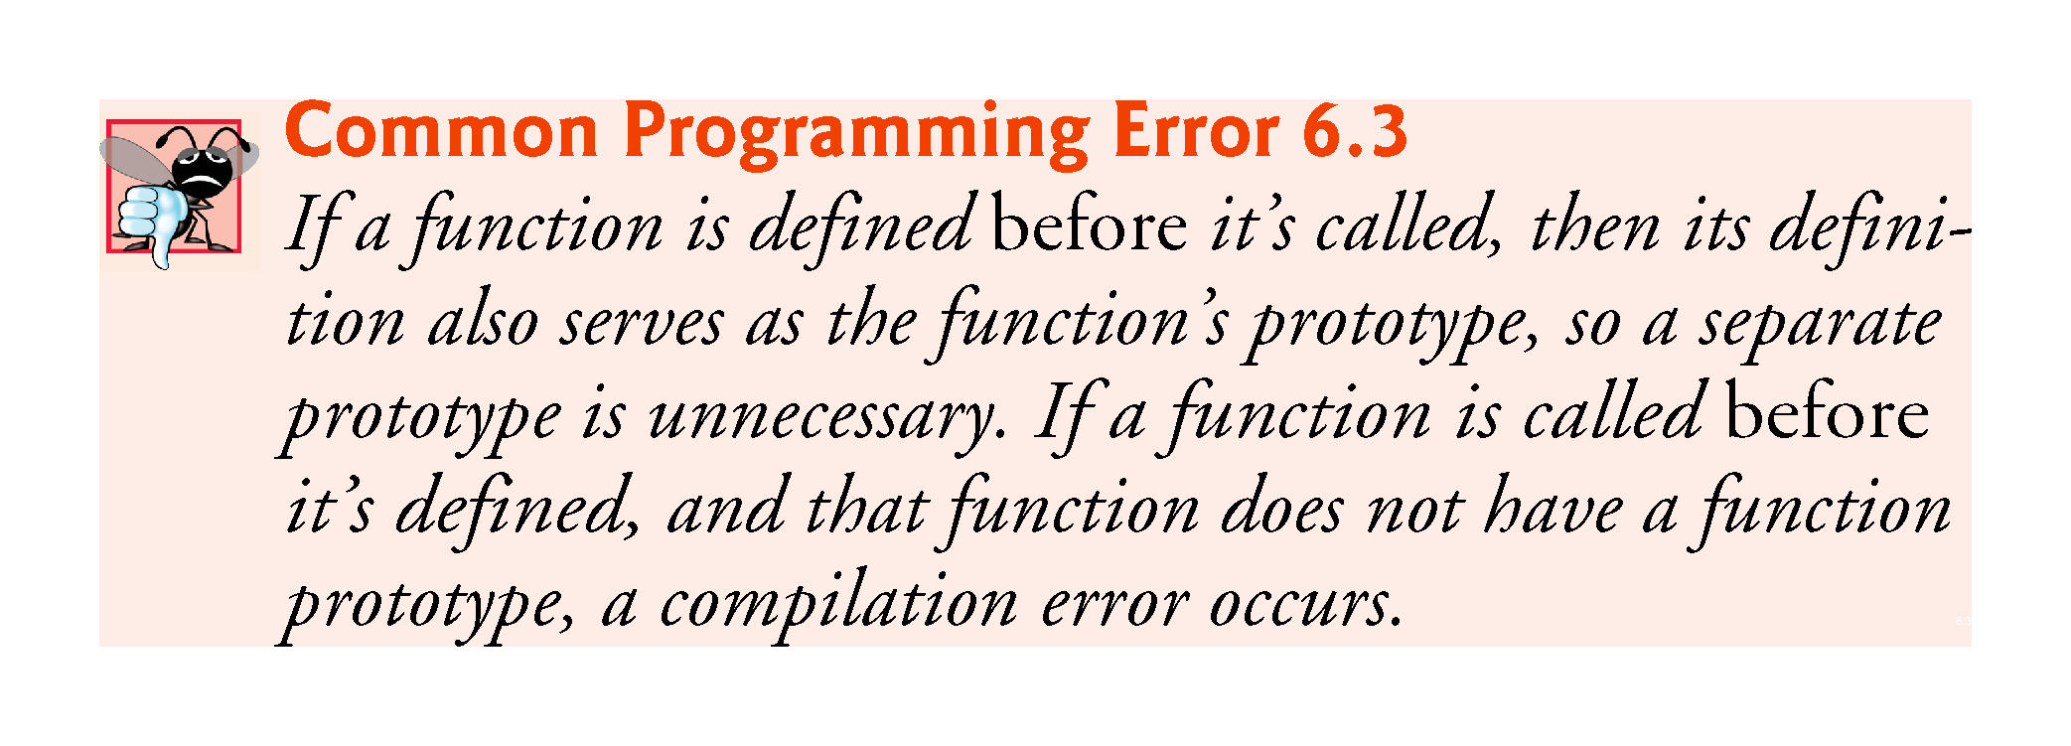
©1992-2017 by Pearson Education, Inc. All Rights Reserved.

Slide 36
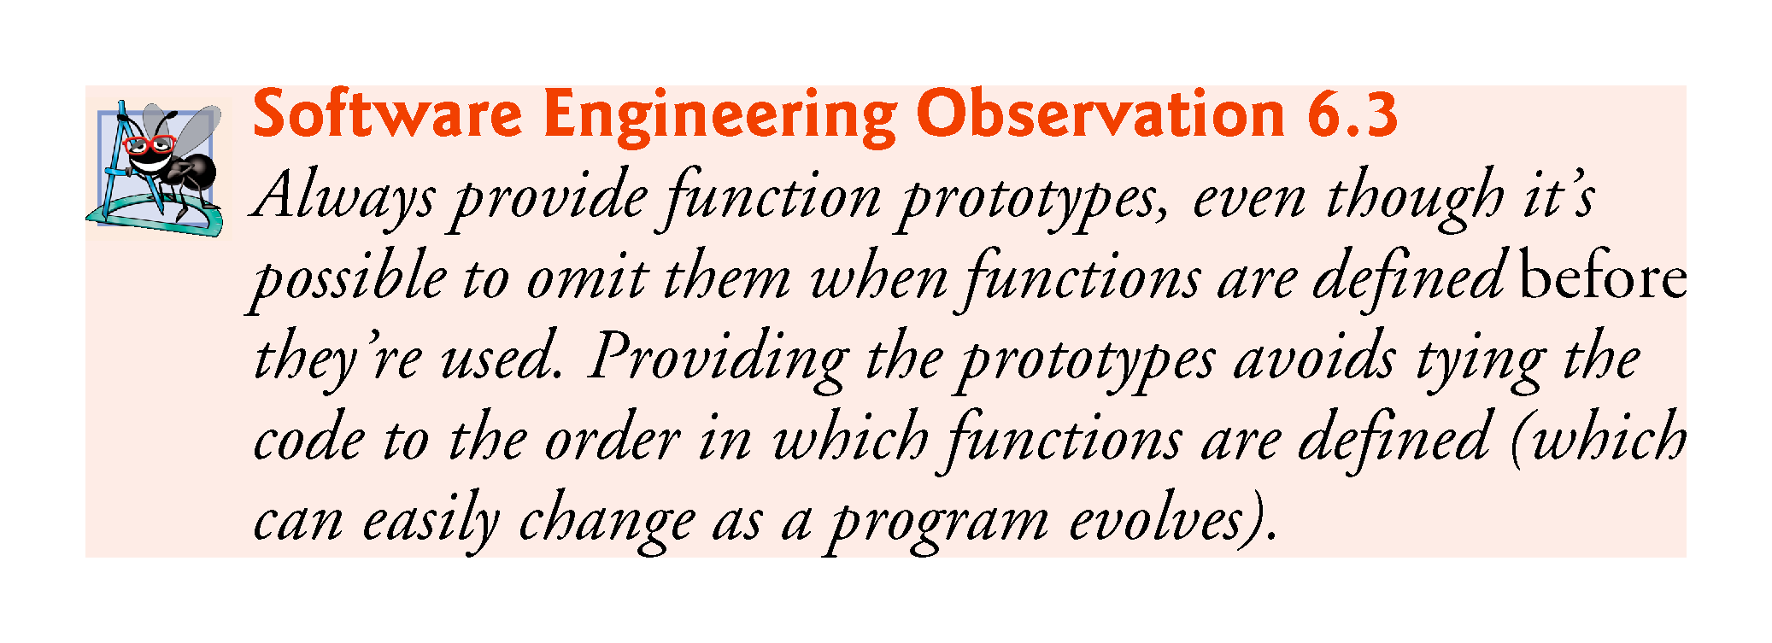
©1992-2017 by Pearson Education, Inc. All Rights Reserved.

Slide 37
6.5.1 Function Signatures and Function Prototypes
The portion of a function prototype that includes the name of the function and the types of its arguments is called the function signature or simply the signature.
Signature does not specify the function’s return type.
The scope of a function is the region of a program in which the function is known and accessible.
©1992-2017 by Pearson Education, Inc. All Rights Reserved.

Slide 38
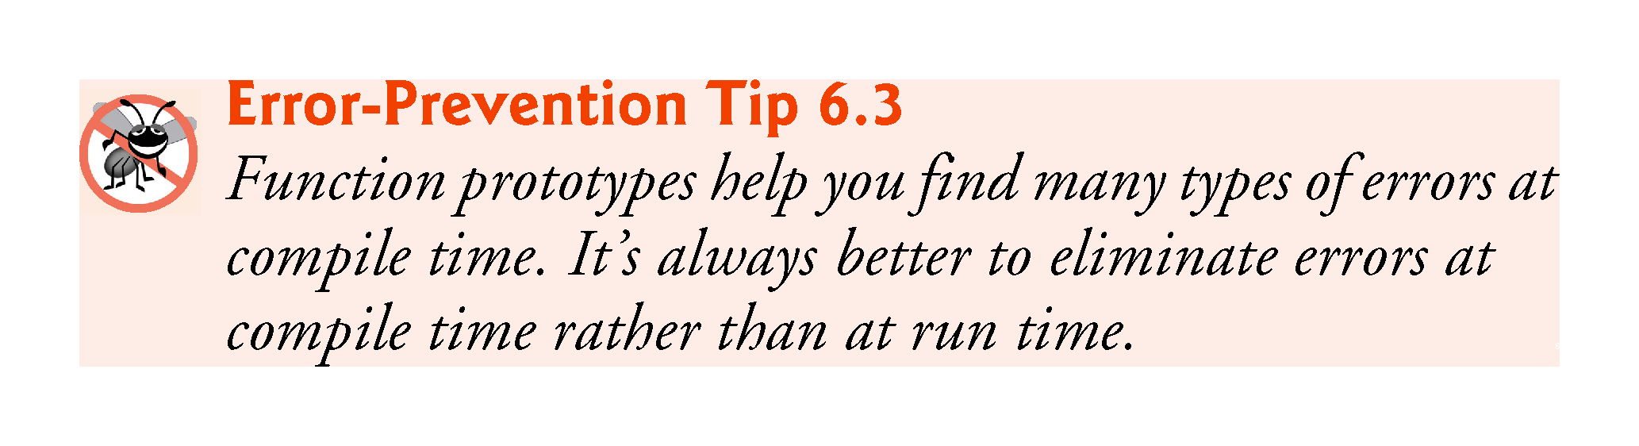
©1992-2017 by Pearson Education, Inc. All Rights Reserved.

Slide 39
6.5.2 Argument Coercion
An important feature of function prototypes is argument coercion
forcing arguments to the appropriate types specified by the parameter declarations.
These conversions occur as specified by C++’s promotion rules.
©1992-2017 by Pearson Education, Inc. All Rights Reserved.

Slide 40
6.5.3 Argument-Promotion Rules and Implicit Conversions
The promotion rules indicate how to convert between types without losing data.
The promotion rules apply to expressions containing values of two or more data types
also referred to as mixed-type expressions.
The type of each value in a mixed-type expression is promoted to the “highest” type in the expression.
©1992-2017 by Pearson Education, Inc. All Rights Reserved.

Slide 41
6.5.3 Argument-Promotion Rules and Implicit Conversions
Figure 6.4 lists the arithmetic data types in order from “highest type” to “lowest type.”
Converting values to lower fundamental types can result in incorrect values.
Therefore, a value can be converted to a lower fundamental type only by explicitly assigning the value to a variable of lower type or by using a cast operator.
©1992-2017 by Pearson Education, Inc. All Rights Reserved.

Slide 42
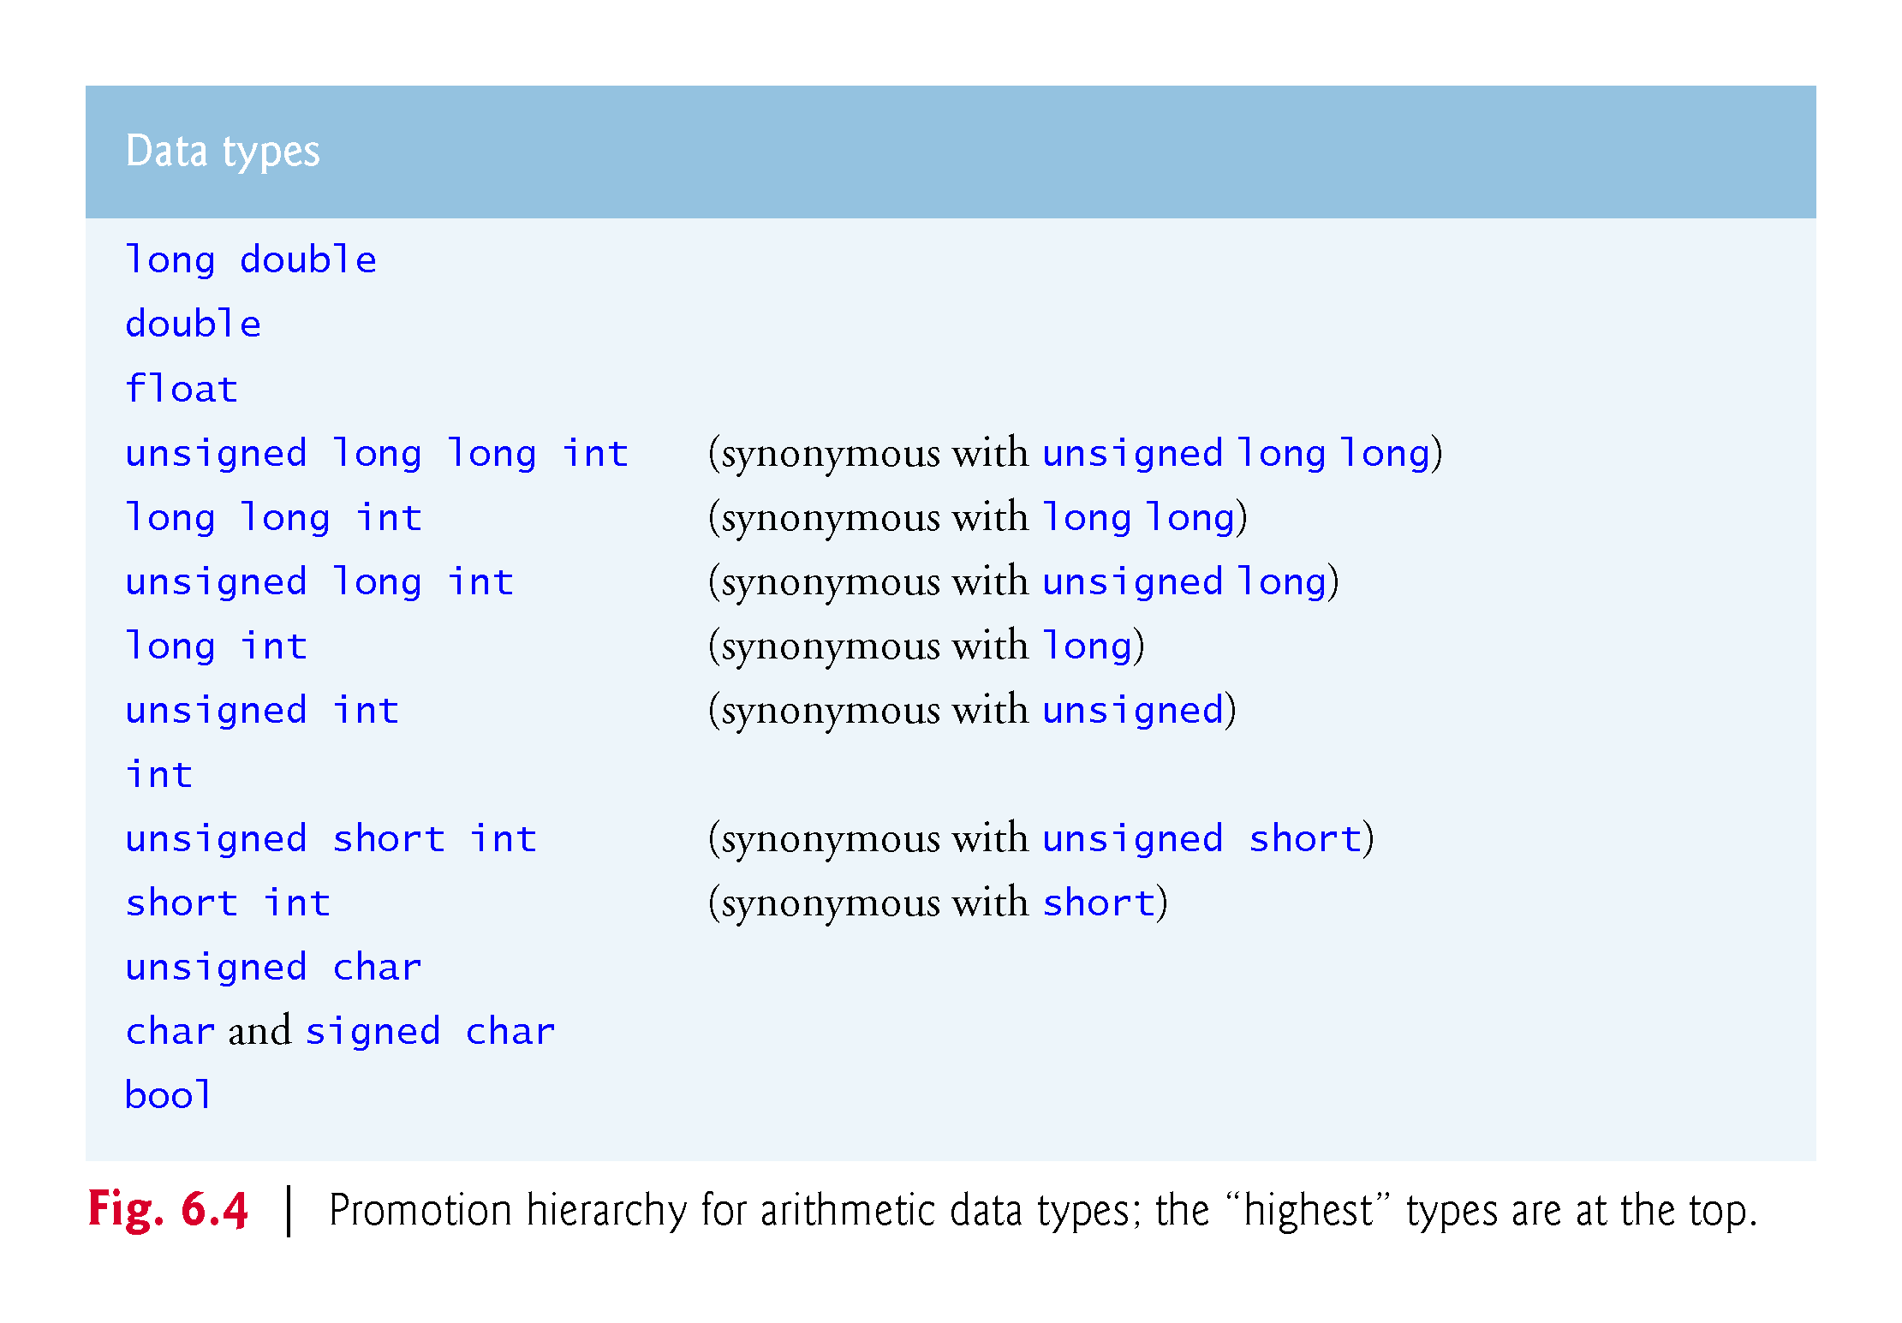
©1992-2017 by Pearson Education, Inc. All Rights Reserved.

Slide 43
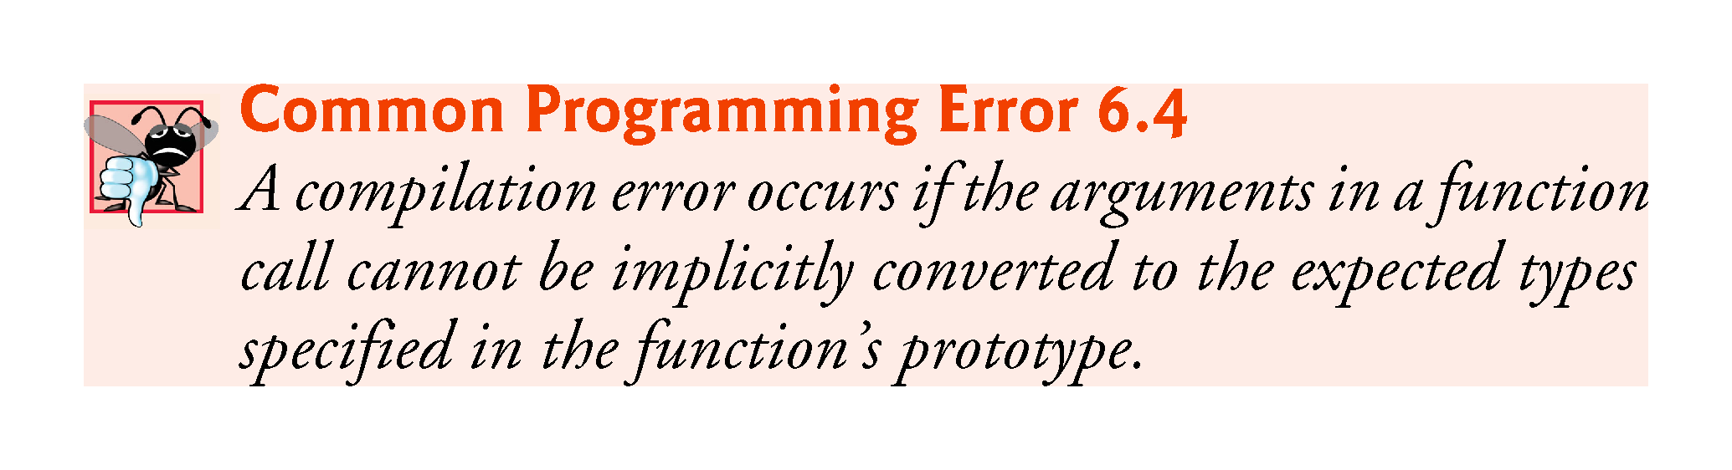
©1992-2017 by Pearson Education, Inc. All Rights Reserved.

Slide 44
6.6 C++ Standard Library Header Files
The C++ Standard Library is divided into many portions, each with its own header file.
The header files contain the function prototypes for the related functions that form each portion of the library.
The header files also contain definitions of various class types and functions, as well as constants needed by those functions.
A header file “instructs” the compiler on how to interface with library and user-written components.
Figure 6.5 lists some common C++ Standard Library header files, most of which are discussed later in the book.
©1992-2017 by Pearson Education, Inc. All Rights Reserved.

Slide 45
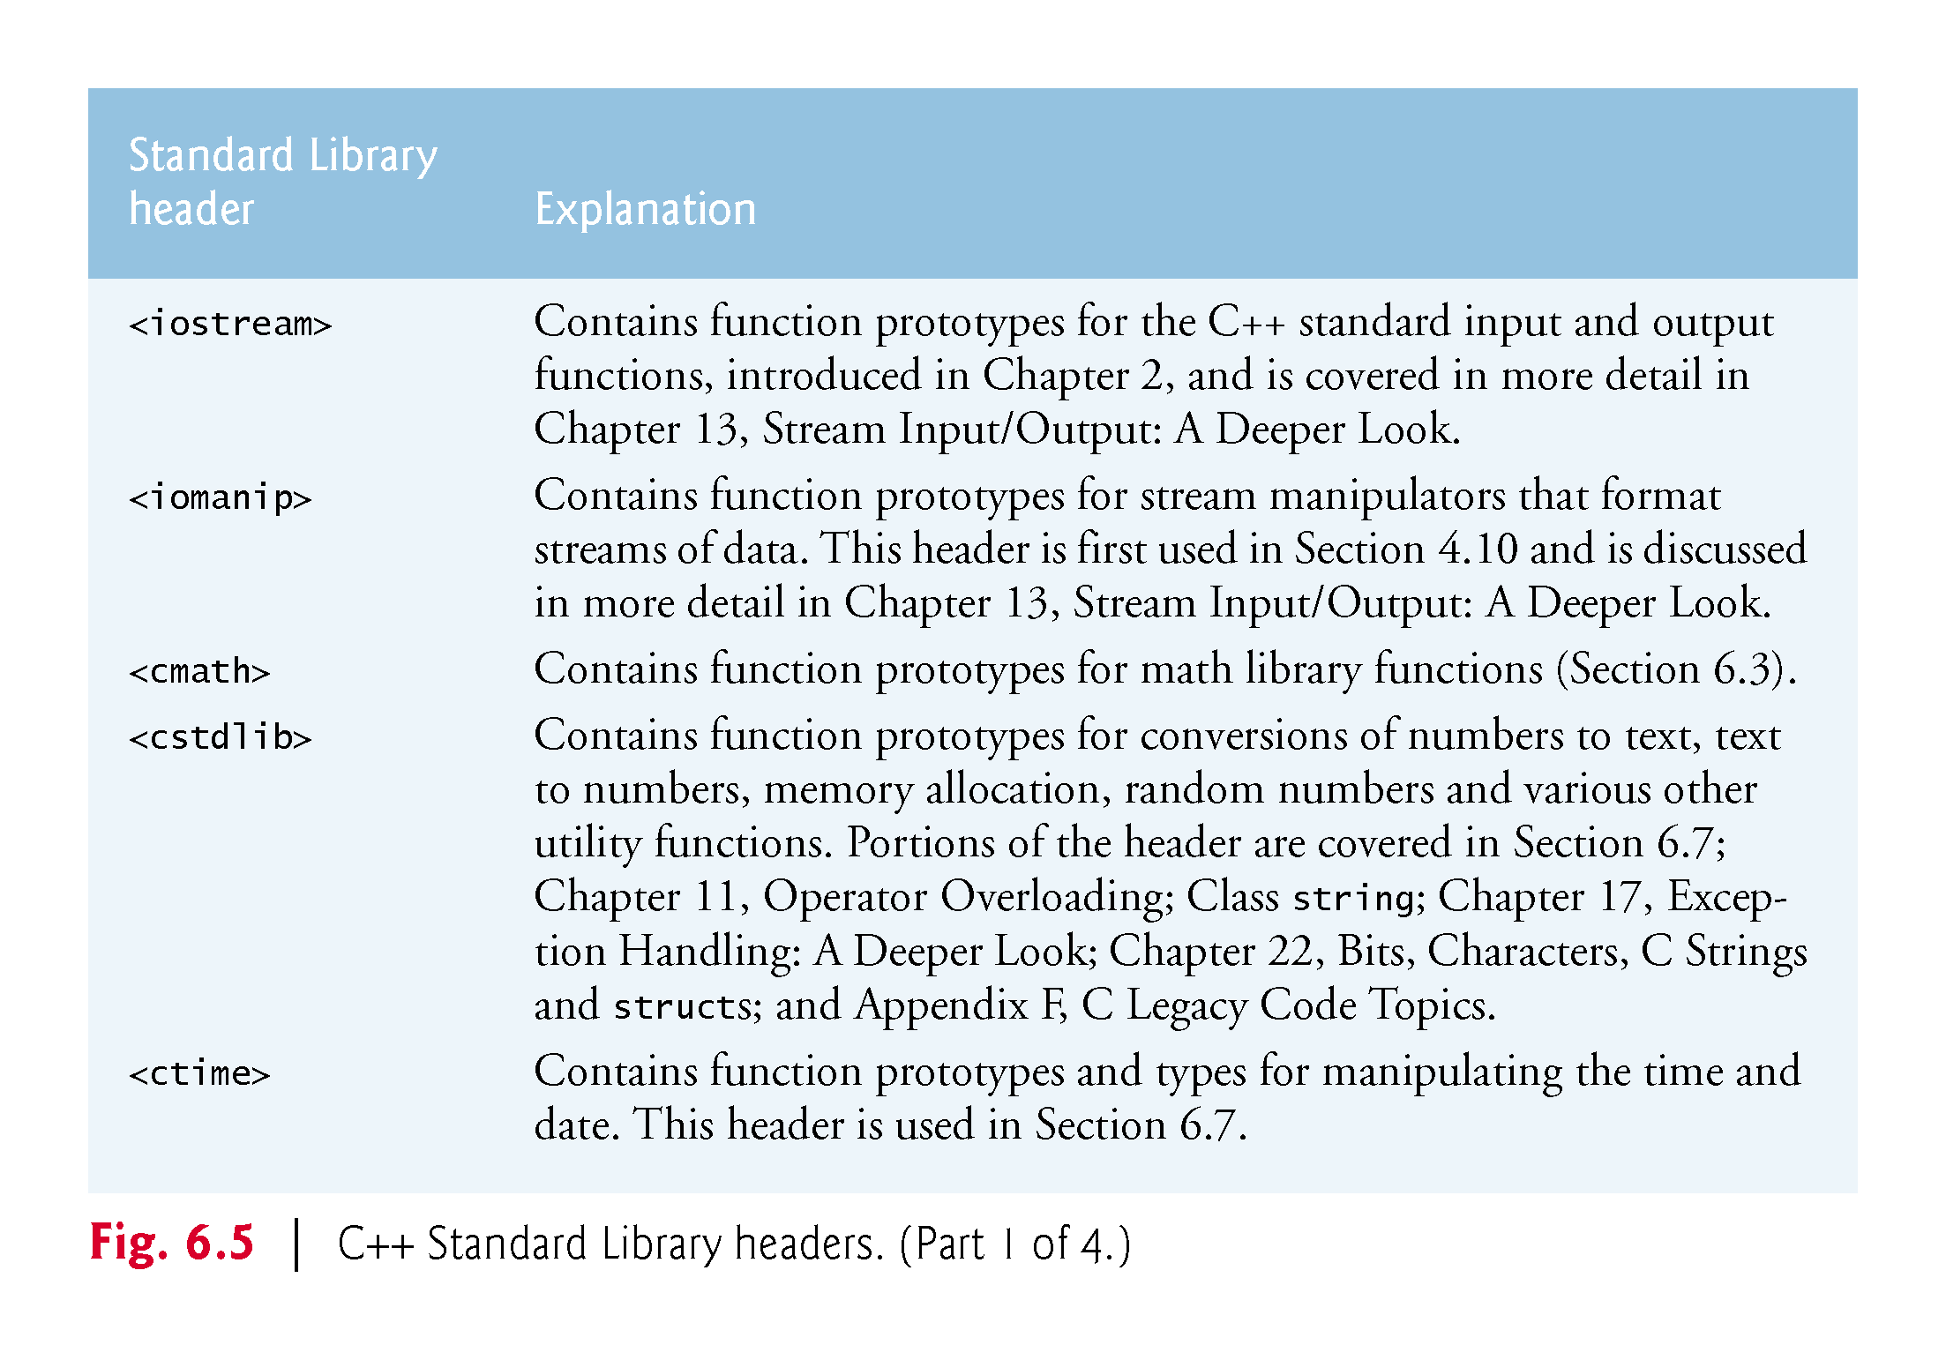
©1992-2017 by Pearson Education, Inc. All Rights Reserved.

Slide 46
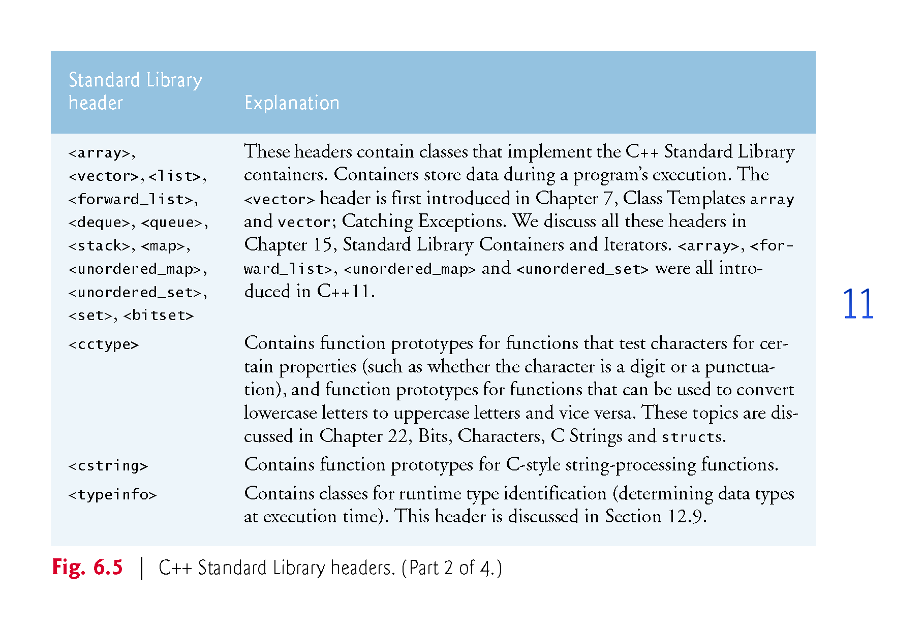
©1992-2017 by Pearson Education, Inc. All Rights Reserved.

Slide 47
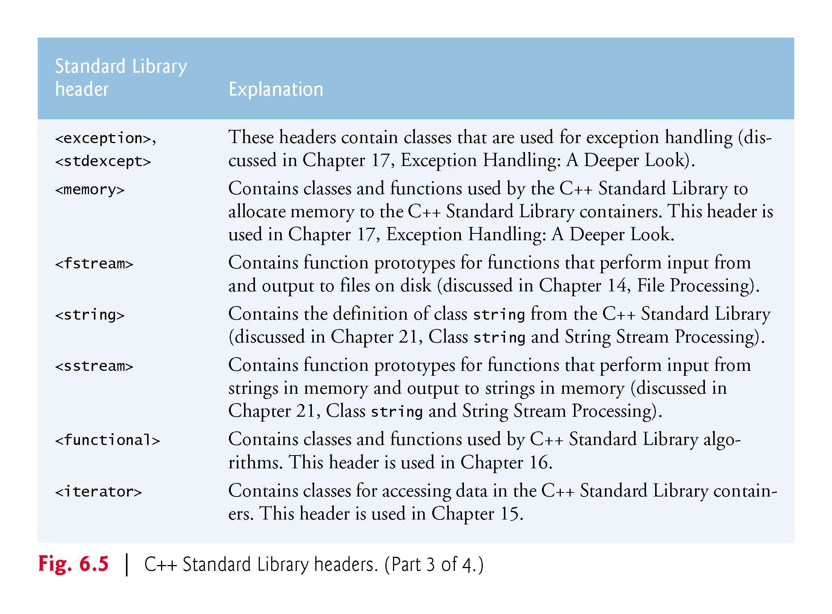
©1992-2017 by Pearson Education, Inc. All Rights Reserved.

Slide 48
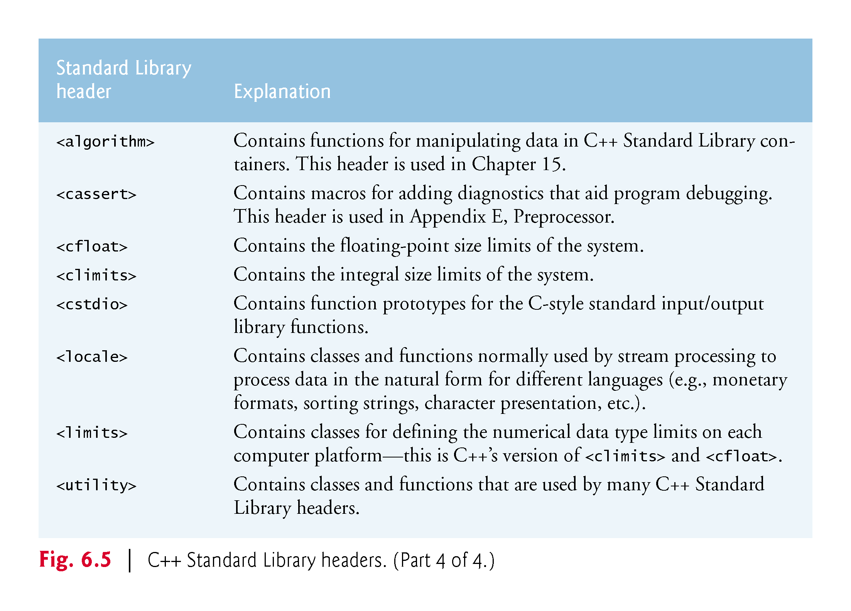
©1992-2017 by Pearson Education, Inc. All Rights Reserved.

Slide 49
6.6.5 Variables – scope and lifetime
When an identifier (that is, a variable, such as “int i”) is declared, it has two important characteristics:
Where is the variable usable (scope).
How long is the variable usable (lifetime).
Click here for a good explanation of these concepts:
http://www.mathcs.emory.edu/~cheung/Courses/561/Syllabus/3-C/scoping.html
©1992-2017 by Pearson Education, Inc. All Rights Reserved.

Slide 50
6.6.5 Scope: 6 kinds
Block scope: A name declared within a function, including the parameter names, has local scope. They are only visible from their point of declaration to the end of the function. Any variable defined within a pair of braces { … } has block scope.
Global namespace scope: A global name is one that is declared outside of any class or function. The scope of global names extends from the point of declaration to the end of the file in which they are declared.
Class scope: Names of class members have class scope, which extends throughout the class definition regardless of the point of declaration.
Function scope Variables declared within a function have function scope, which means it is visible throughout a function body even before its point of declaration.
Function-prototype scope: Names used in a function prototype are visible until the end of the prototype declaration.
Namespace scope: A name that is declared within a namespace, outside of any class or enum definition or function block, is visible from its point of declaration to the end of namespace.
©1992-2017 by Pearson Education, Inc. All Rights Reserved.

Slide 51
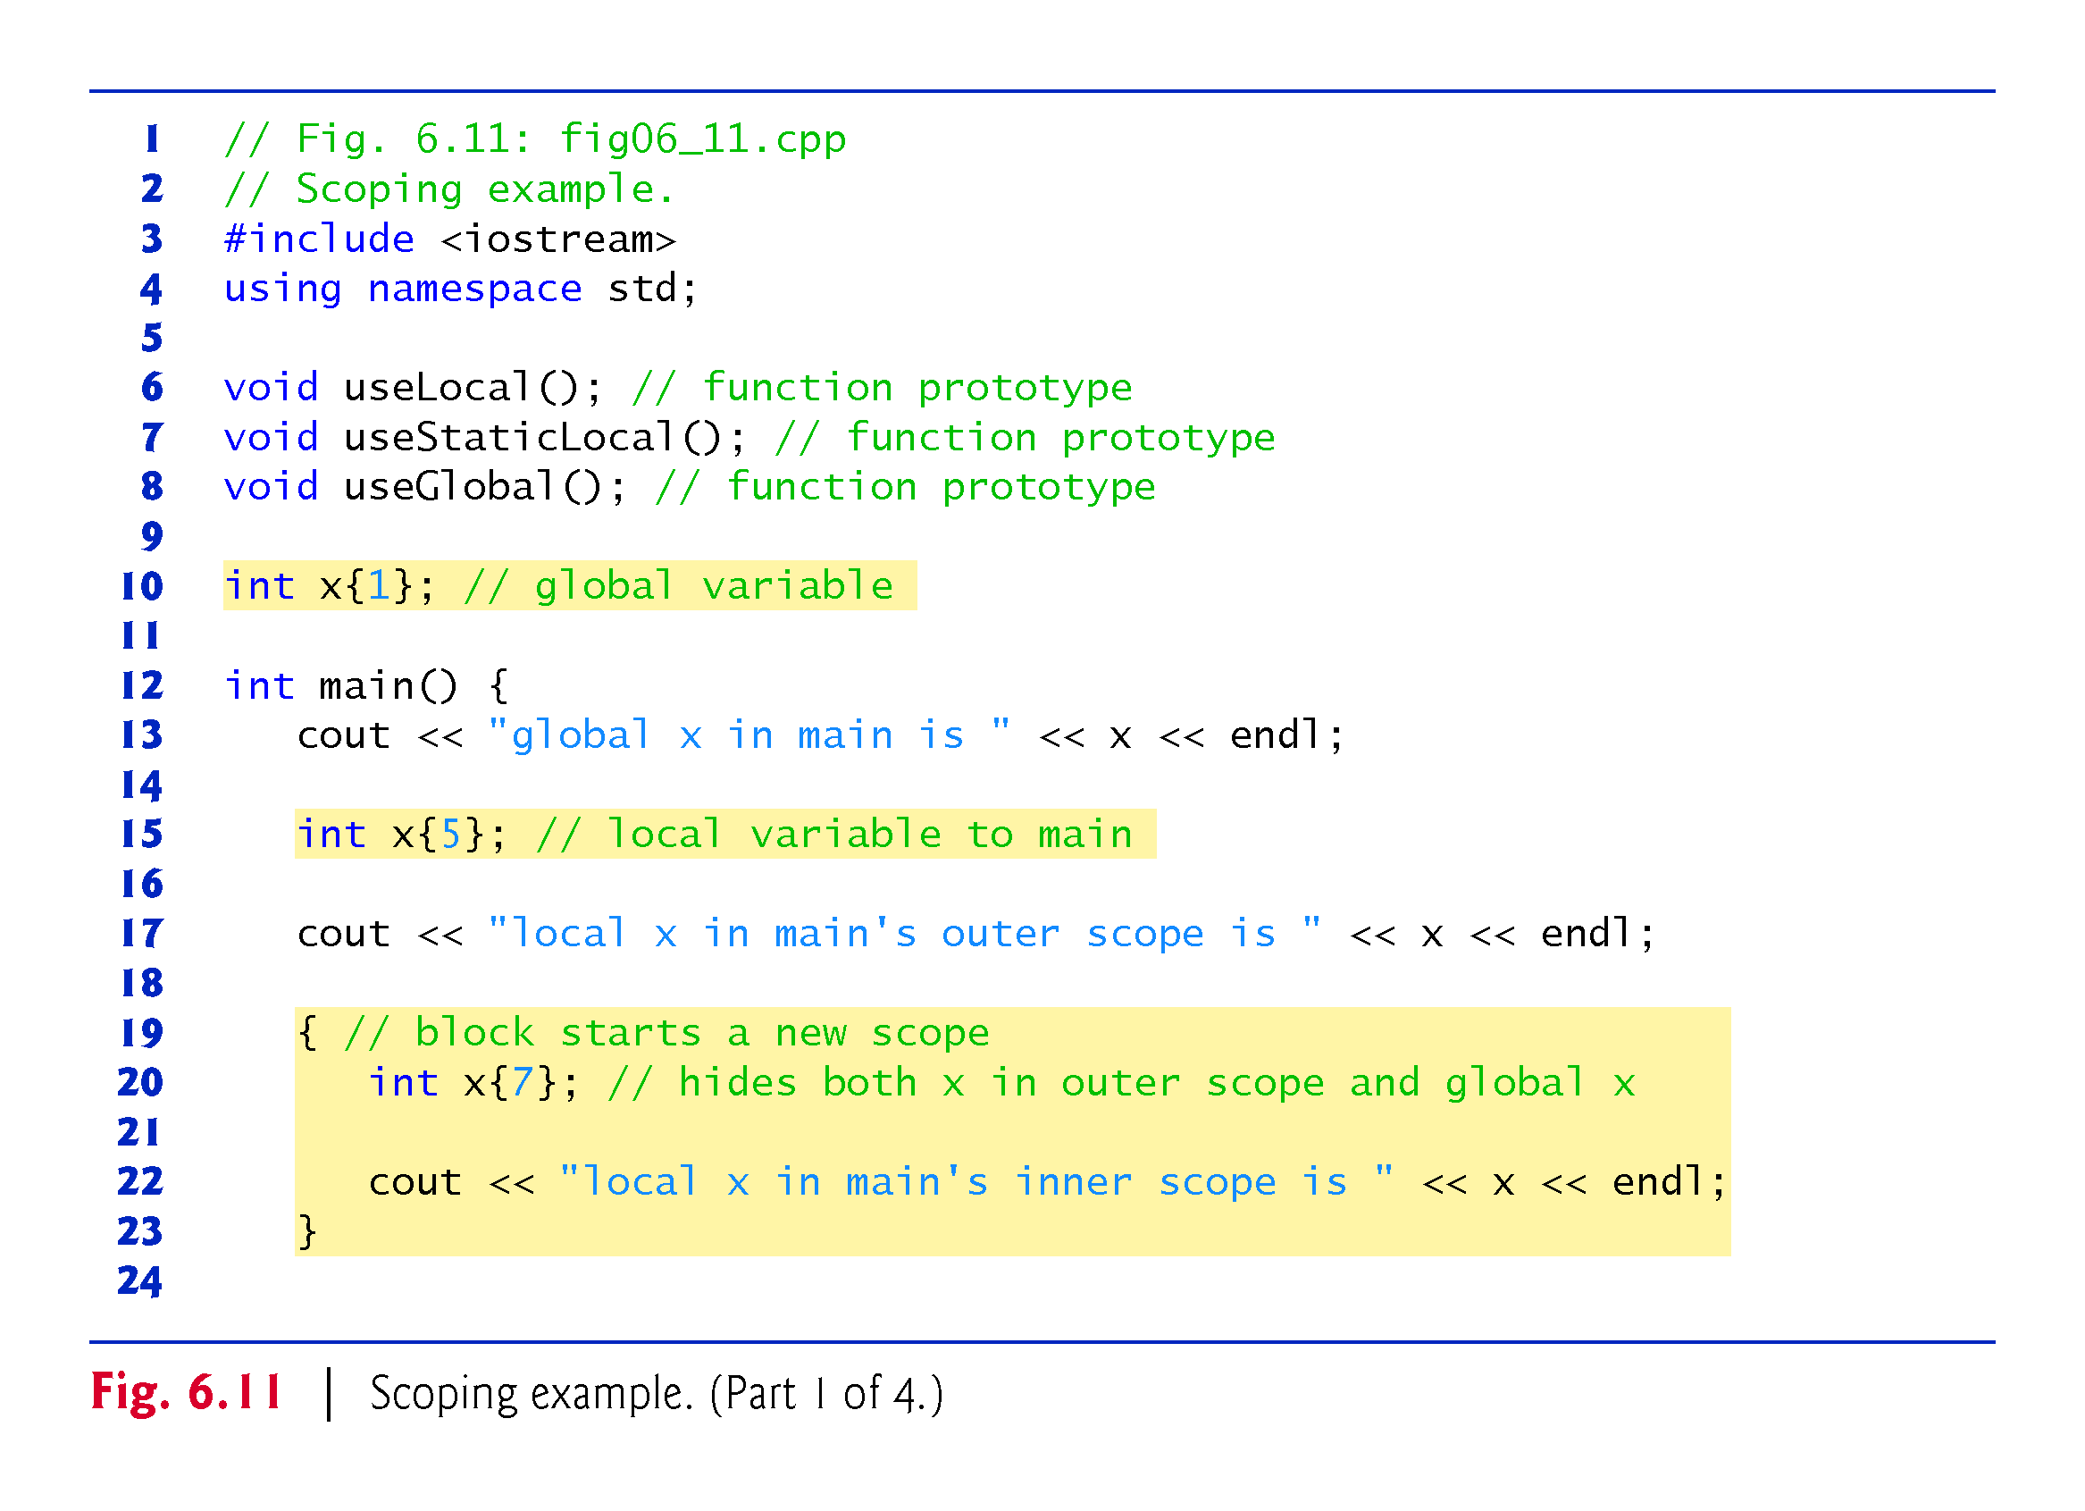
©1992-2017 by Pearson Education, Inc. All Rights Reserved.

Slide 52
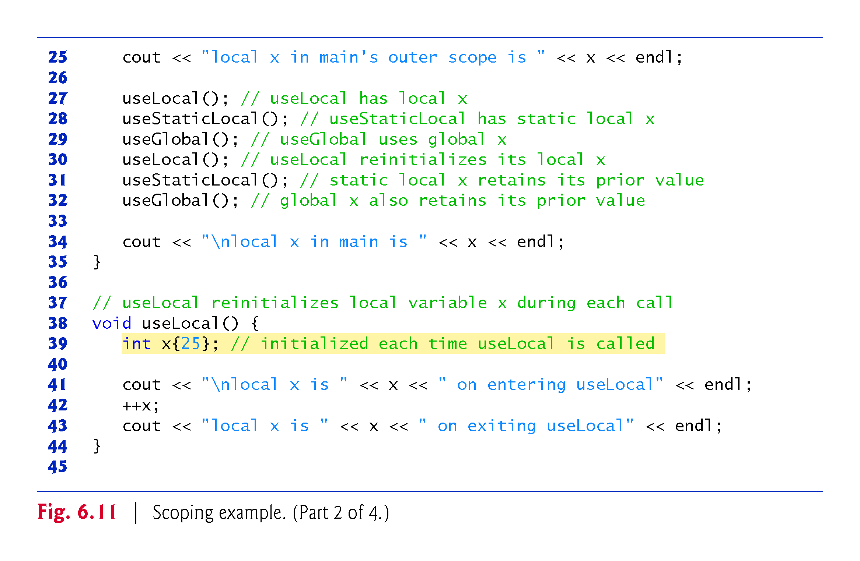
©1992-2017 by Pearson Education, Inc. All Rights Reserved.

Slide 53
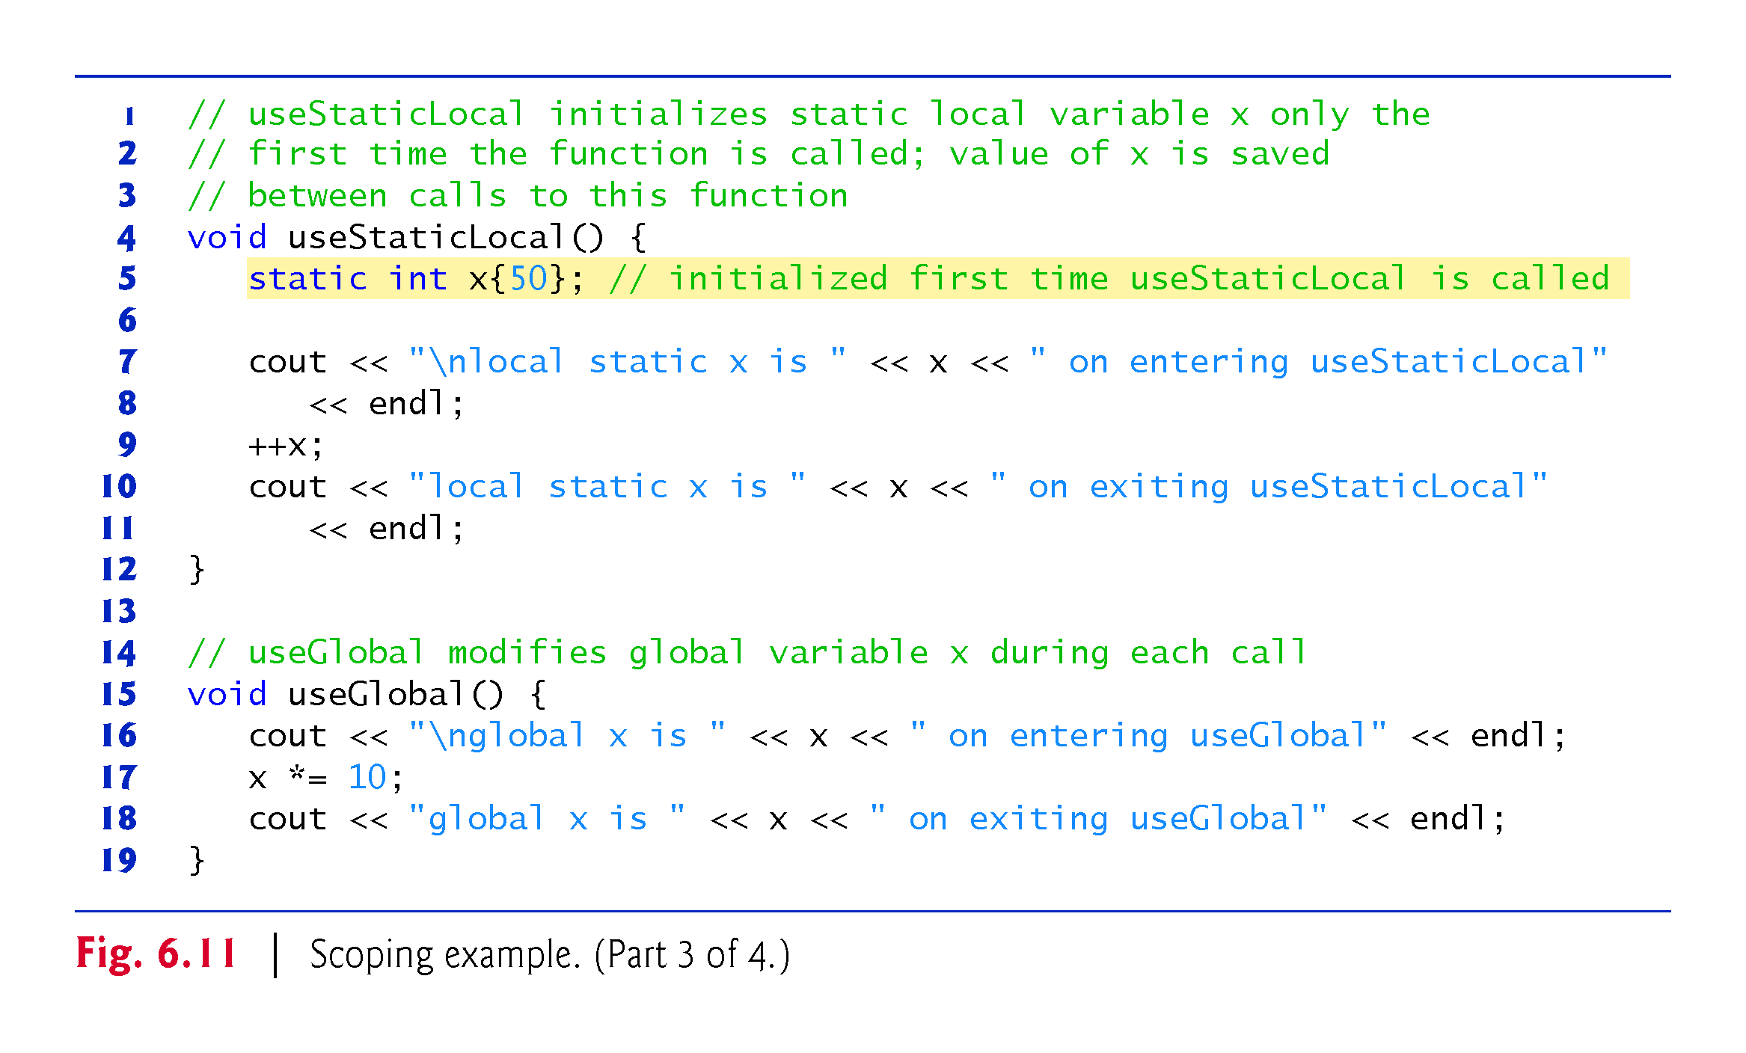
©1992-2017 by Pearson Education, Inc. All Rights Reserved.

Slide 54
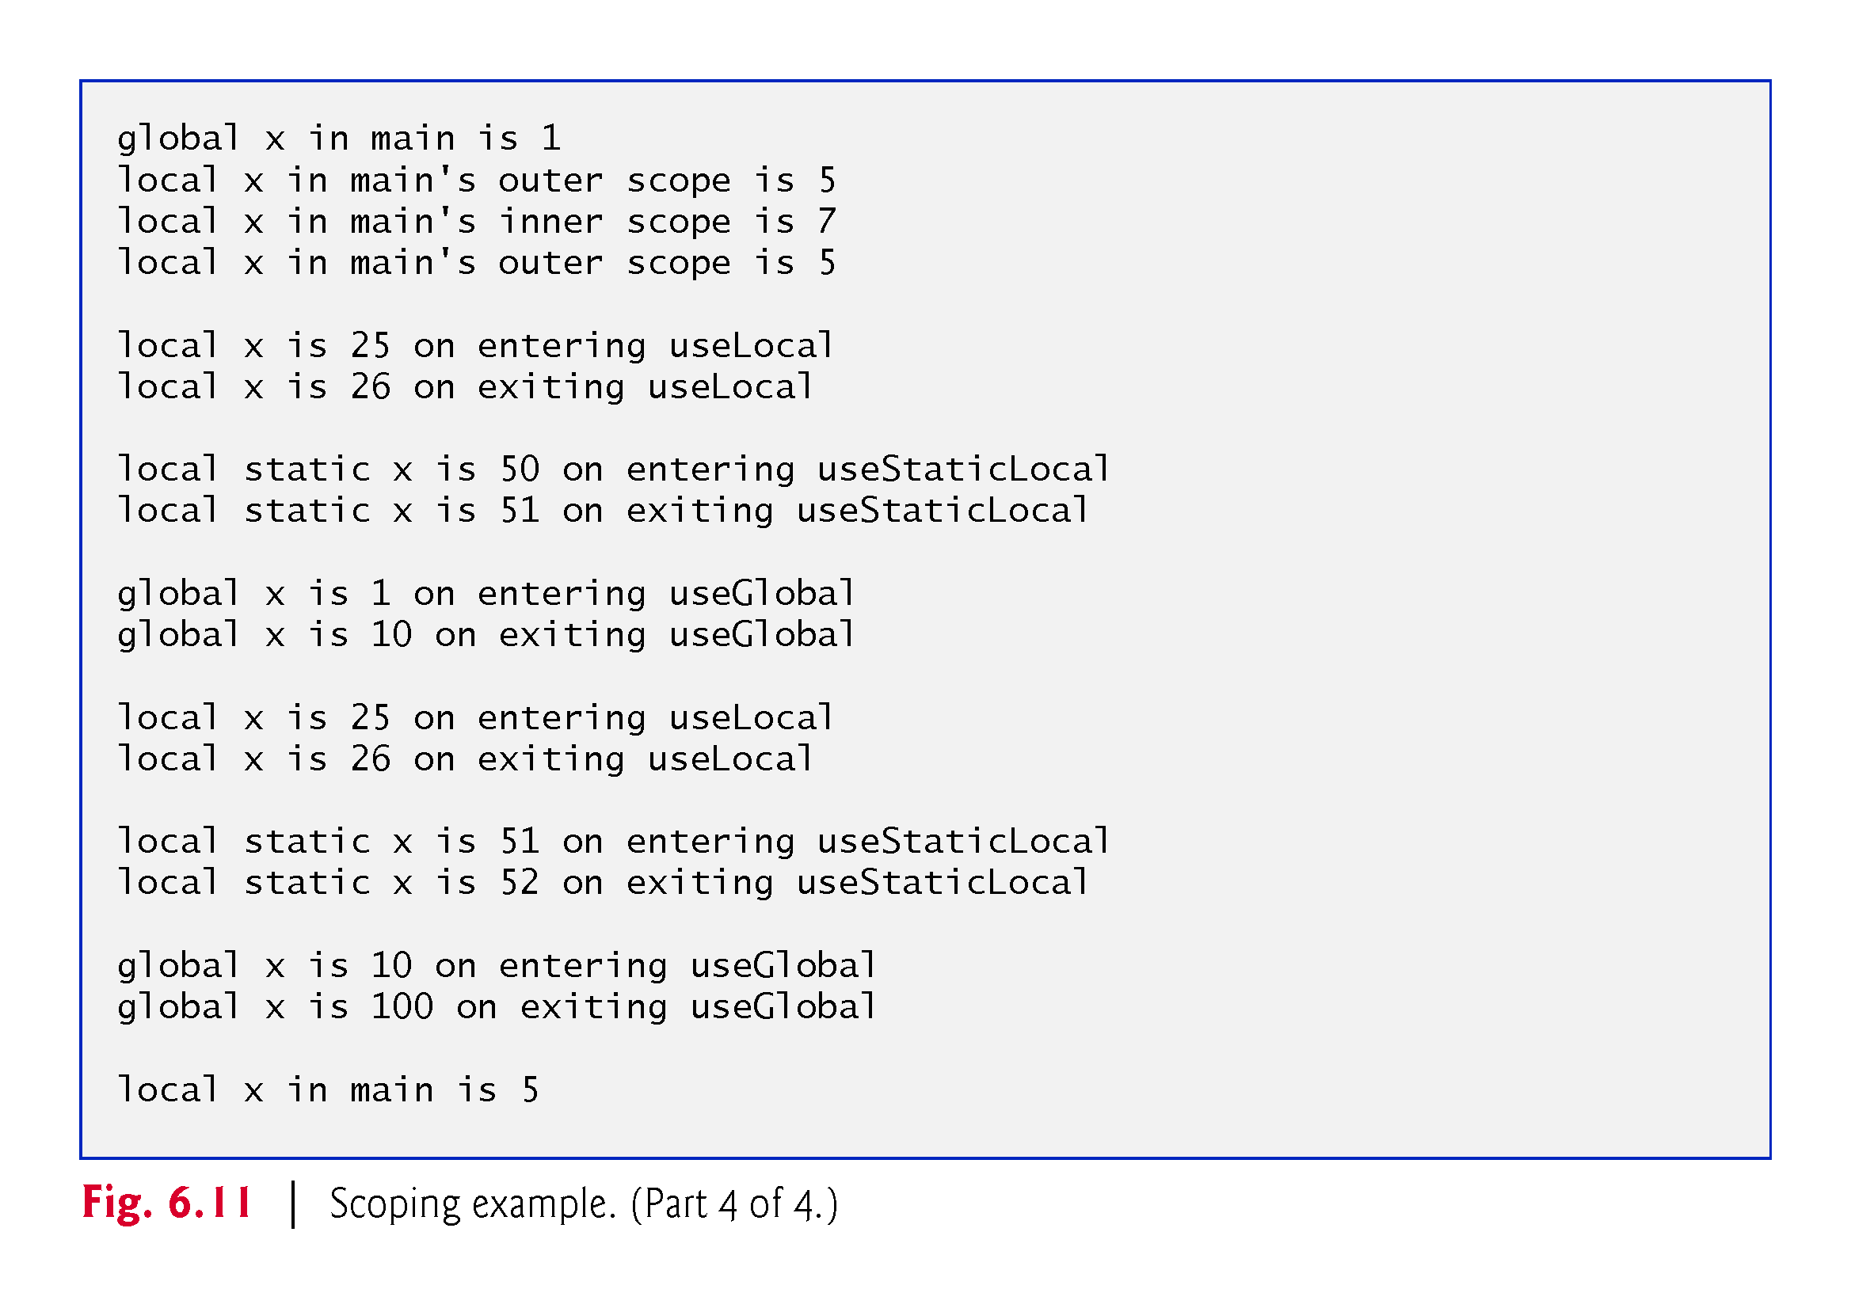
©1992-2017 by Pearson Education, Inc. All Rights Reserved.

Slide 55
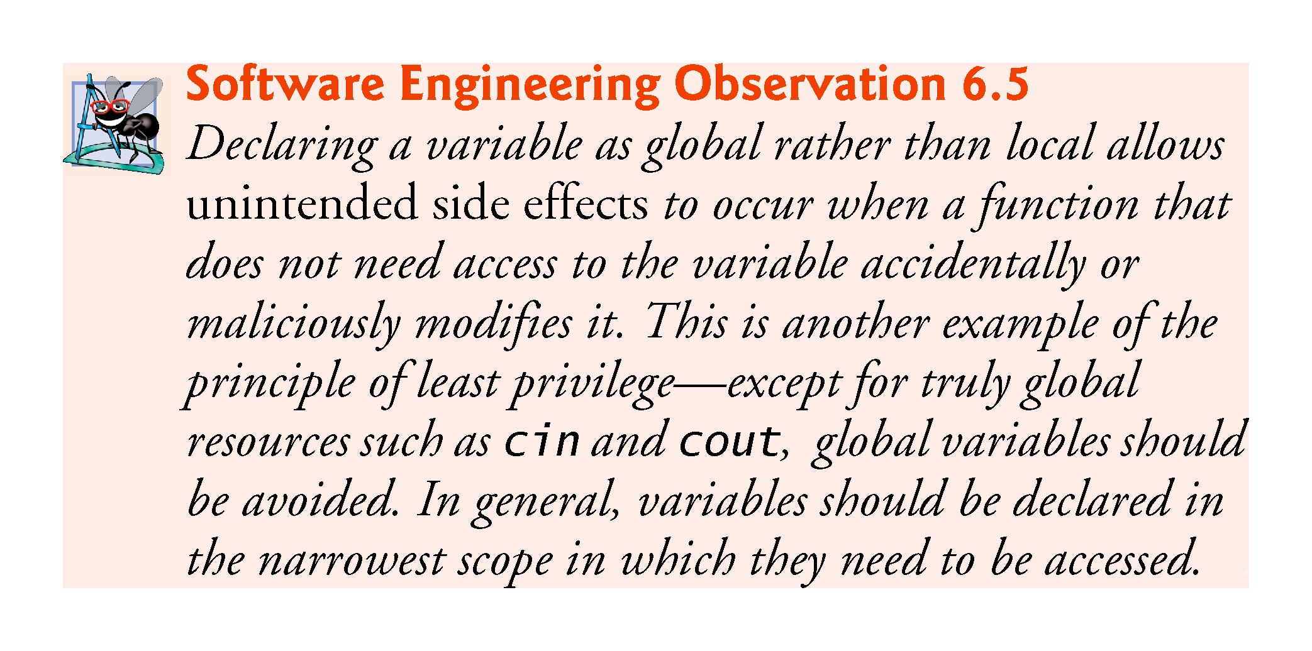
©1992-2017 by Pearson Education, Inc. All Rights Reserved.

Slide 56
6.7 Case Study: Random Number Generation
The element of chance can be introduced into computer applications by using the C++ Standard Library function rand.
The function rand generates an unsigned integer between 0 and RAND_MAX (a symbolic constant defined in the <cstdlib> header file).
For GNU C++, the value of RAND_MAX is 2147483647; for Visual Studio, the value of RAND_MAX is 32767.
If rand truly produces integers at random, every number between 0 and RAND_MAX has an equal chance (or probability) of being chosen each time rand is called.
To find the value of RAND_MAX, write a program with #include <cstdlib> and type cout << RAND_MAX << endl;
©1992-2017 by Pearson Education, Inc. All Rights Reserved.

Slide 57
6.7.1 Rolling a Six-Sided Die
The function prototype for the rand function is in <cstdlib>.
To produce integers in the range 0 to 5, we use the modulus operator (%) with rand:
rand() % 6
This is called scaling.
The number 6 is called the scaling factor. Six values are produced.
We can shift the range of numbers produced by adding a value.
©1992-2017 by Pearson Education, Inc. All Rights Reserved.

Slide 58
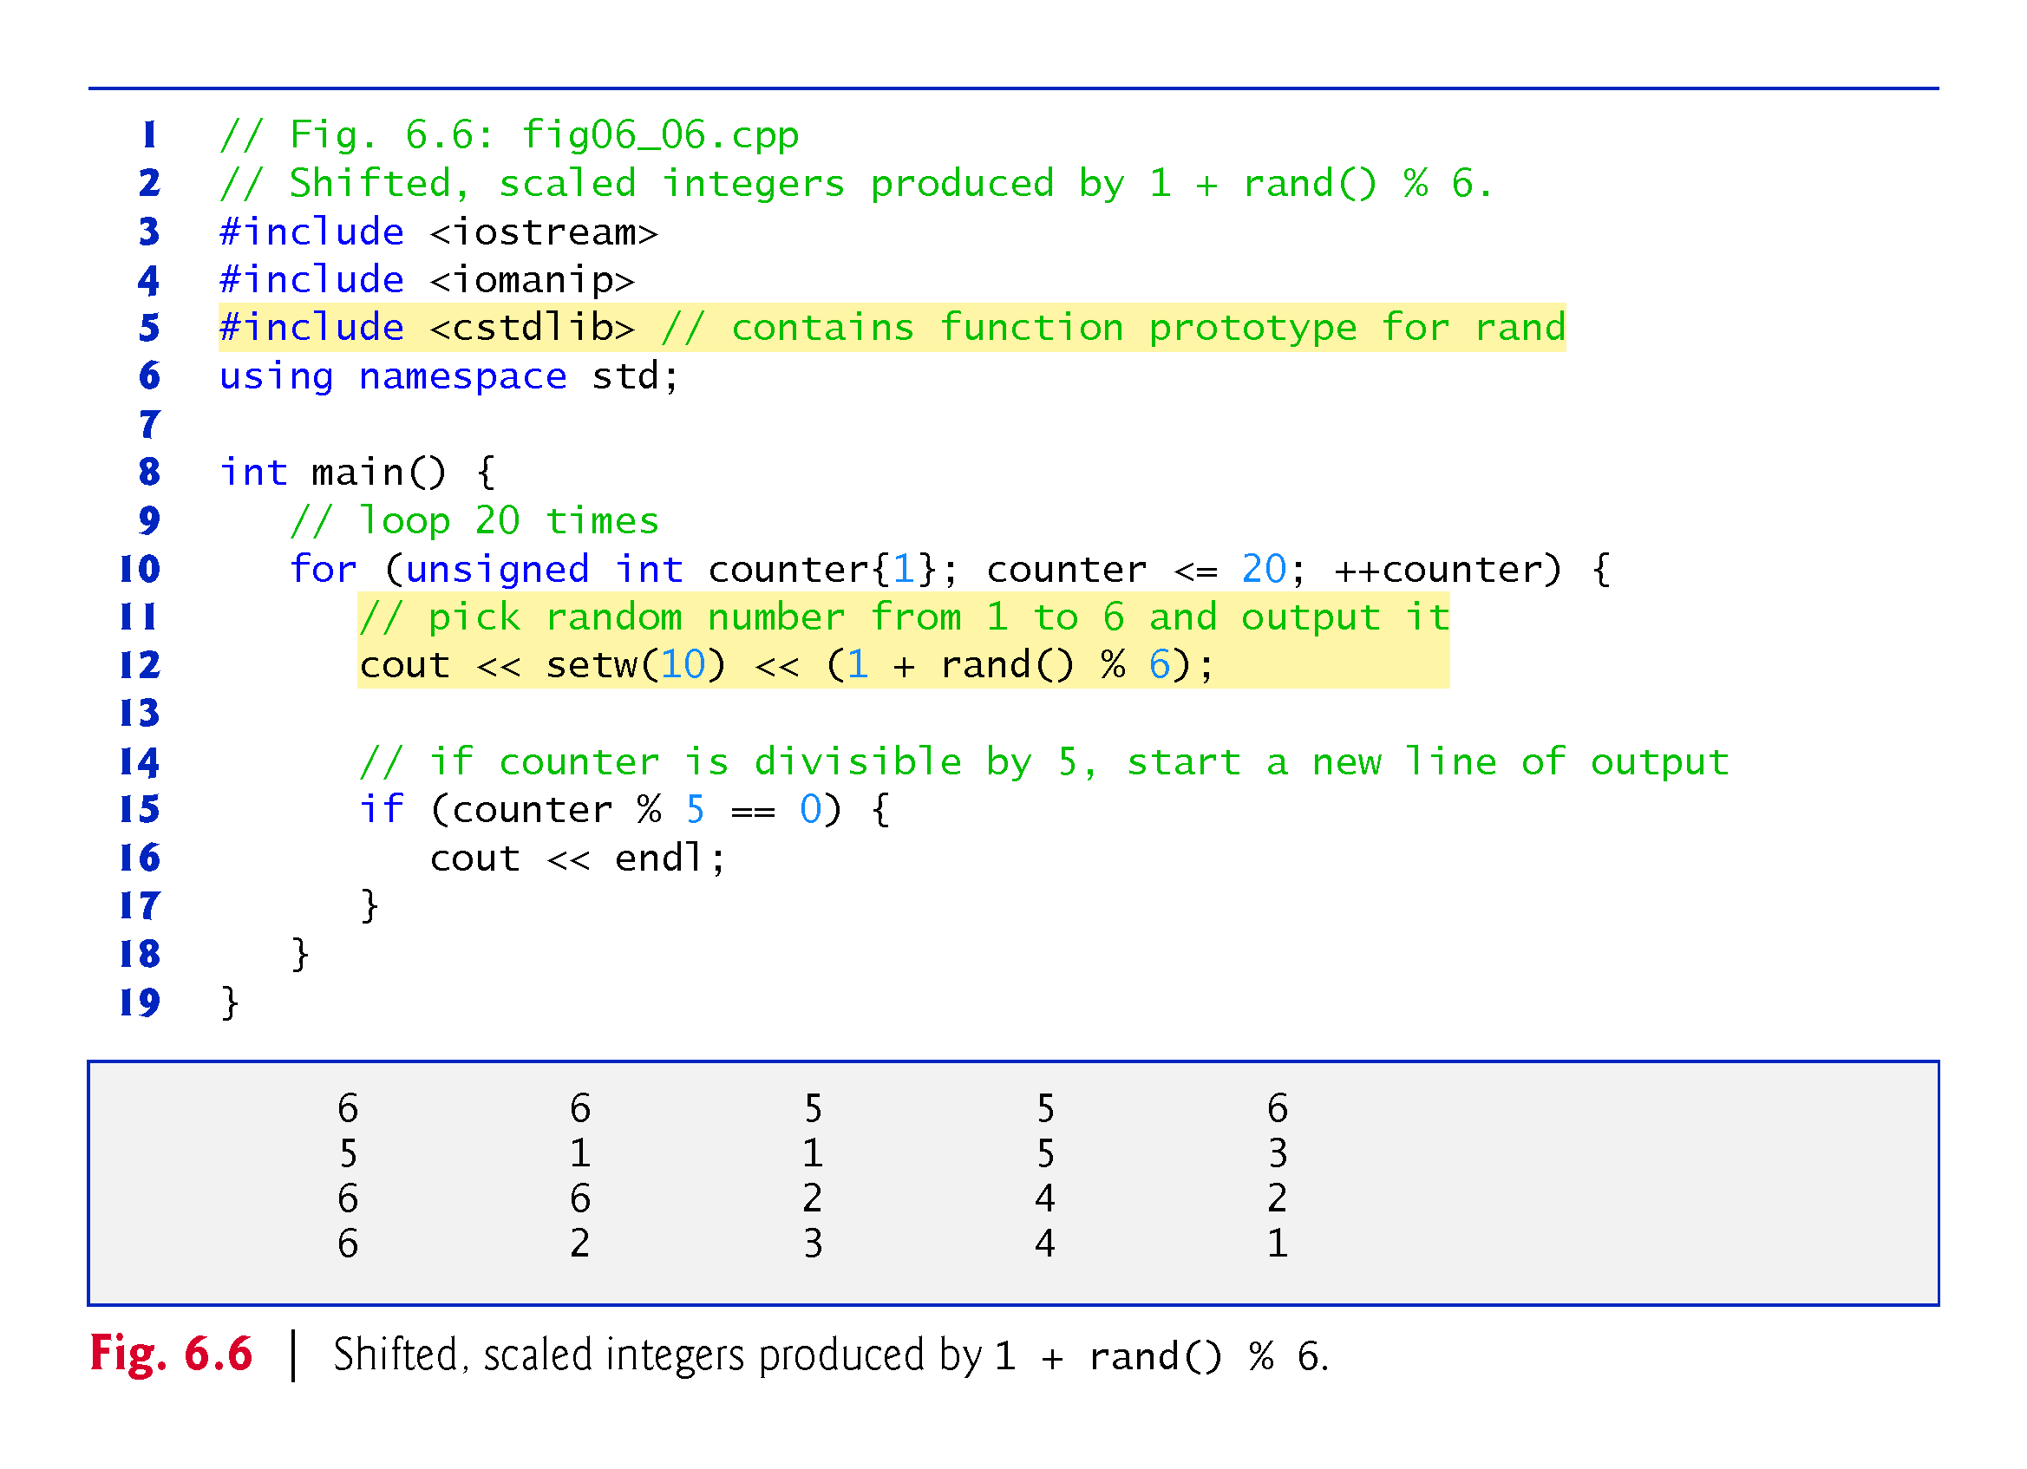
©1992-2017 by Pearson Education, Inc. All Rights Reserved.

Slide 59
6.7.2 Rolling a Six-Sided Die 60,000,000 Times
To show that the numbers produced by rand occur with approximately equal likelihood, Fig. 6.7 simulates 60,000,000 rolls of a die.
Each integer in the range 1 to 6 should appear approximately 10,000,000 times.
©1992-2017 by Pearson Education, Inc. All Rights Reserved.

Slide 60
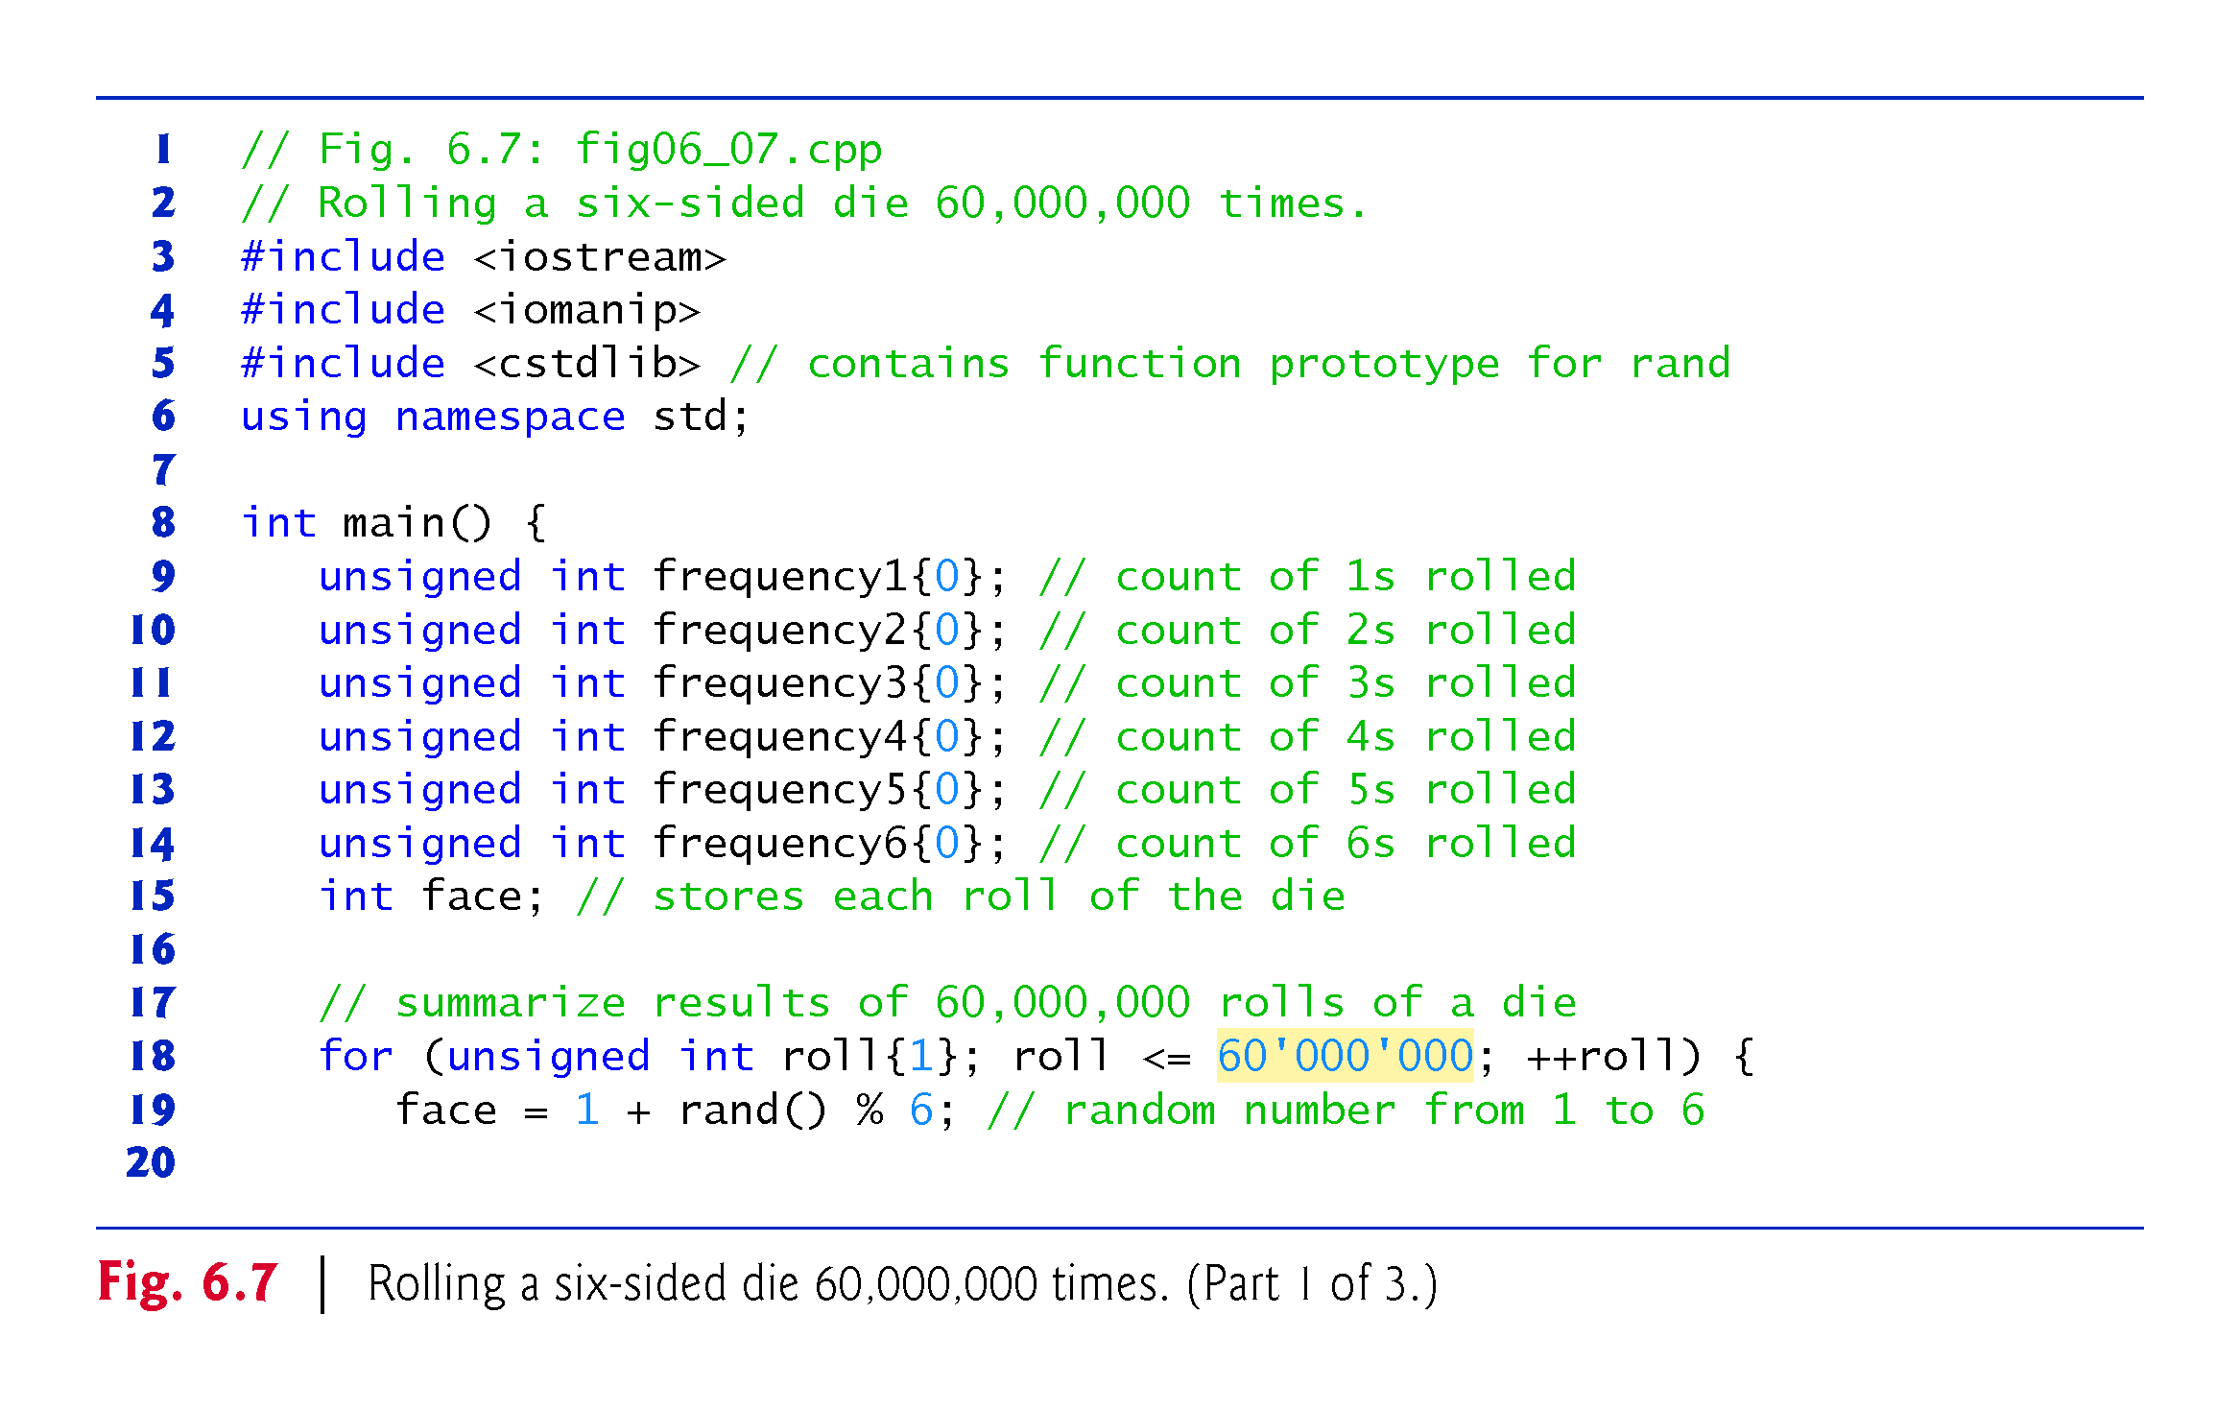
©1992-2017 by Pearson Education, Inc. All Rights Reserved.

Slide 61
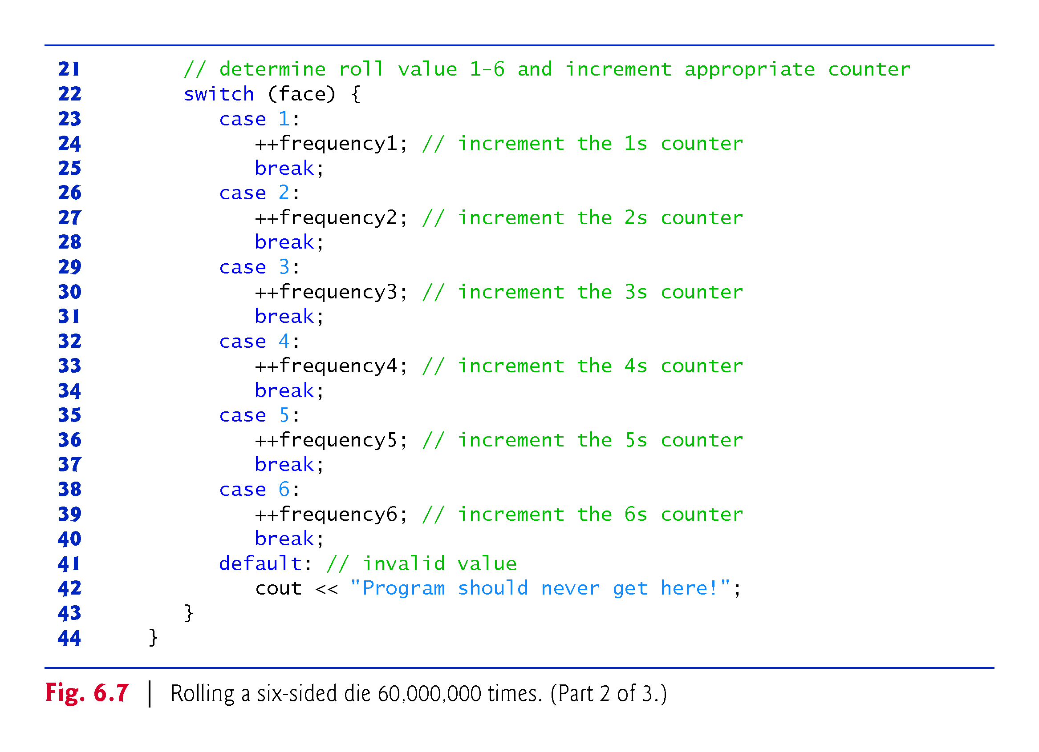
©1992-2017 by Pearson Education, Inc. All Rights Reserved.

Slide 62
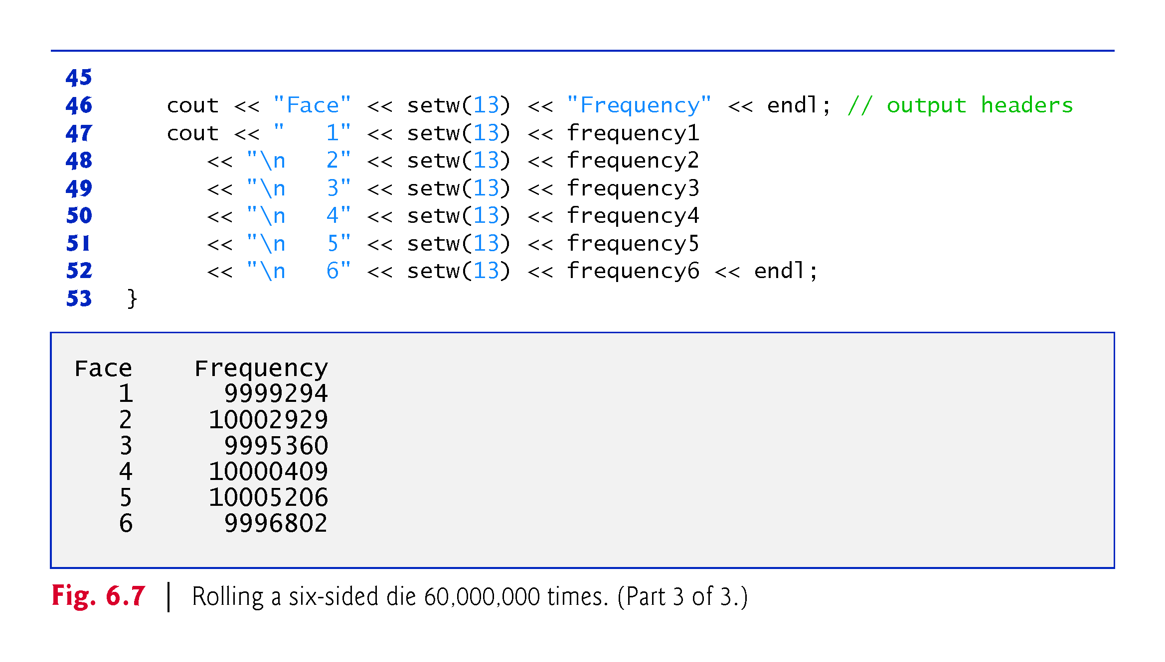
©1992-2017 by Pearson Education, Inc. All Rights Reserved.

Slide 63
6.7.3 Randomizing the Random-Number Generator with srand
Executing the program of Fig. 6.6 again produces exactly the same sequence of values.
Repeatability is an important characteristic of rand.
Can help with testing and debugging.
rand generates pseudorandom numbers.
a sequence of numbers that appears to be random.
sequence repeats itself each time the program executes.
©1992-2017 by Pearson Education, Inc. All Rights Reserved.

Slide 64
6.7.3 Randomizing the Random-Number Generator with srand
Once a program has been debugged, it can be conditioned to produce a different sequence of random numbers for each execution.
This is called randomizing and is accomplished with the C++ Standard Library function srand.
Takes an unsigned integer argument and seeds rand to produce a different sequence of random numbers for each execution.
©1992-2017 by Pearson Education, Inc. All Rights Reserved.

Slide 65
6.7 Case Study: Random Number Generation (cont.)
Seeding the Random Number Generator with srand
Figure 6.8 demonstrates function srand.
©1992-2017 by Pearson Education, Inc. All Rights Reserved.

Slide 66
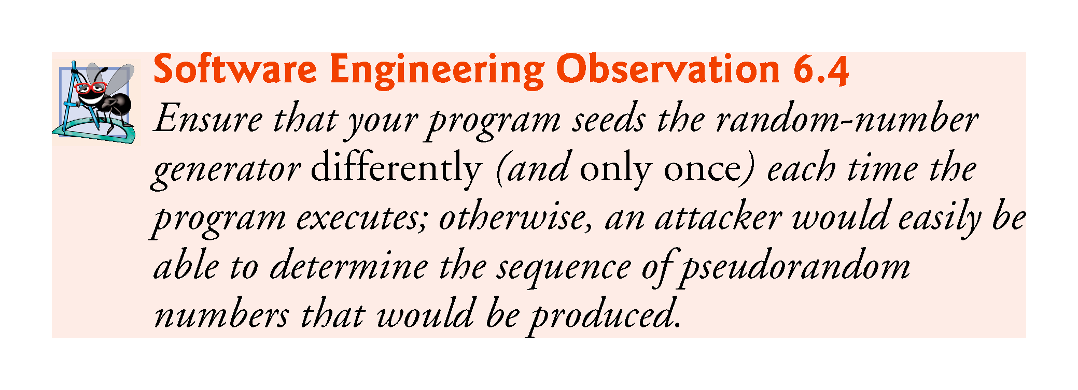
©1992-2017 by Pearson Education, Inc. All Rights Reserved.

Slide 67
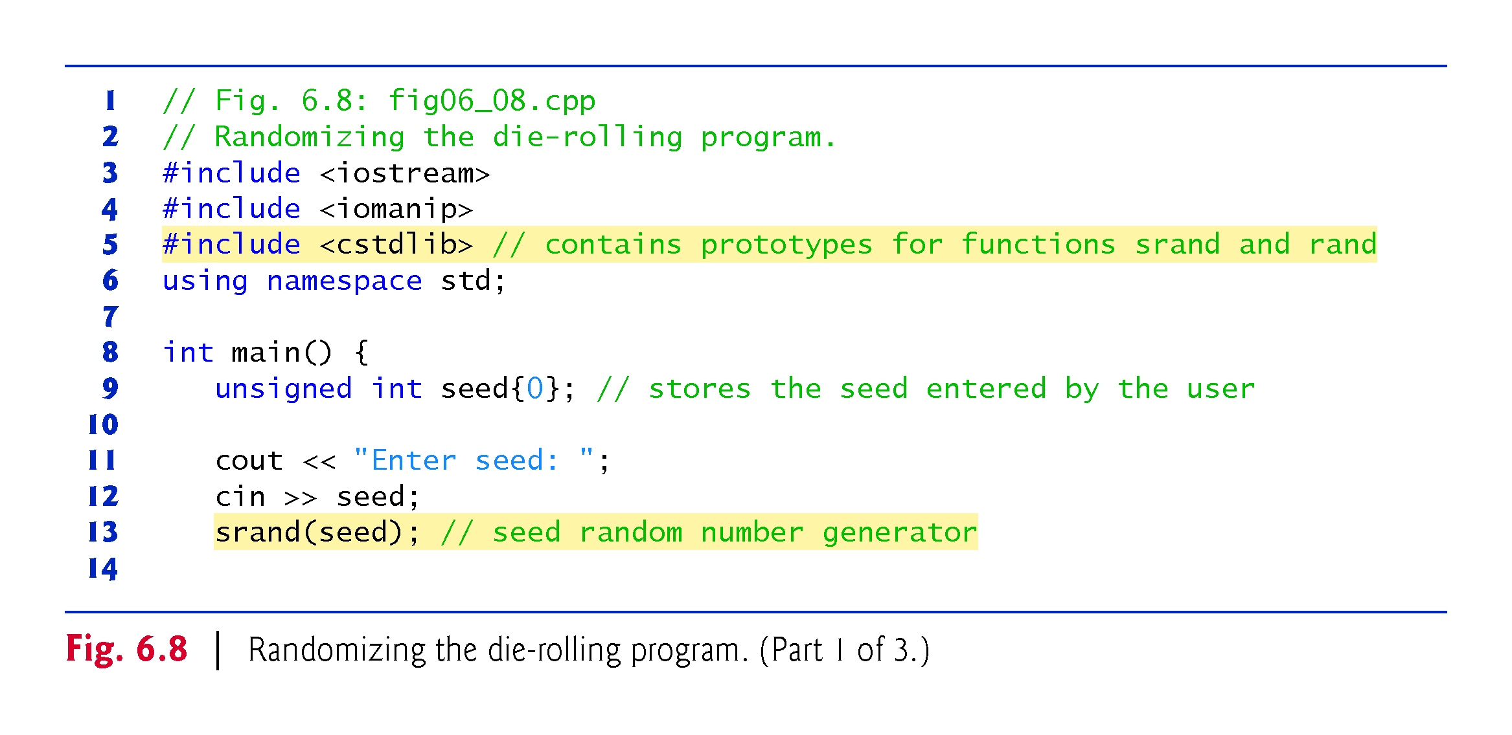
©1992-2017 by Pearson Education, Inc. All Rights Reserved.

Slide 68
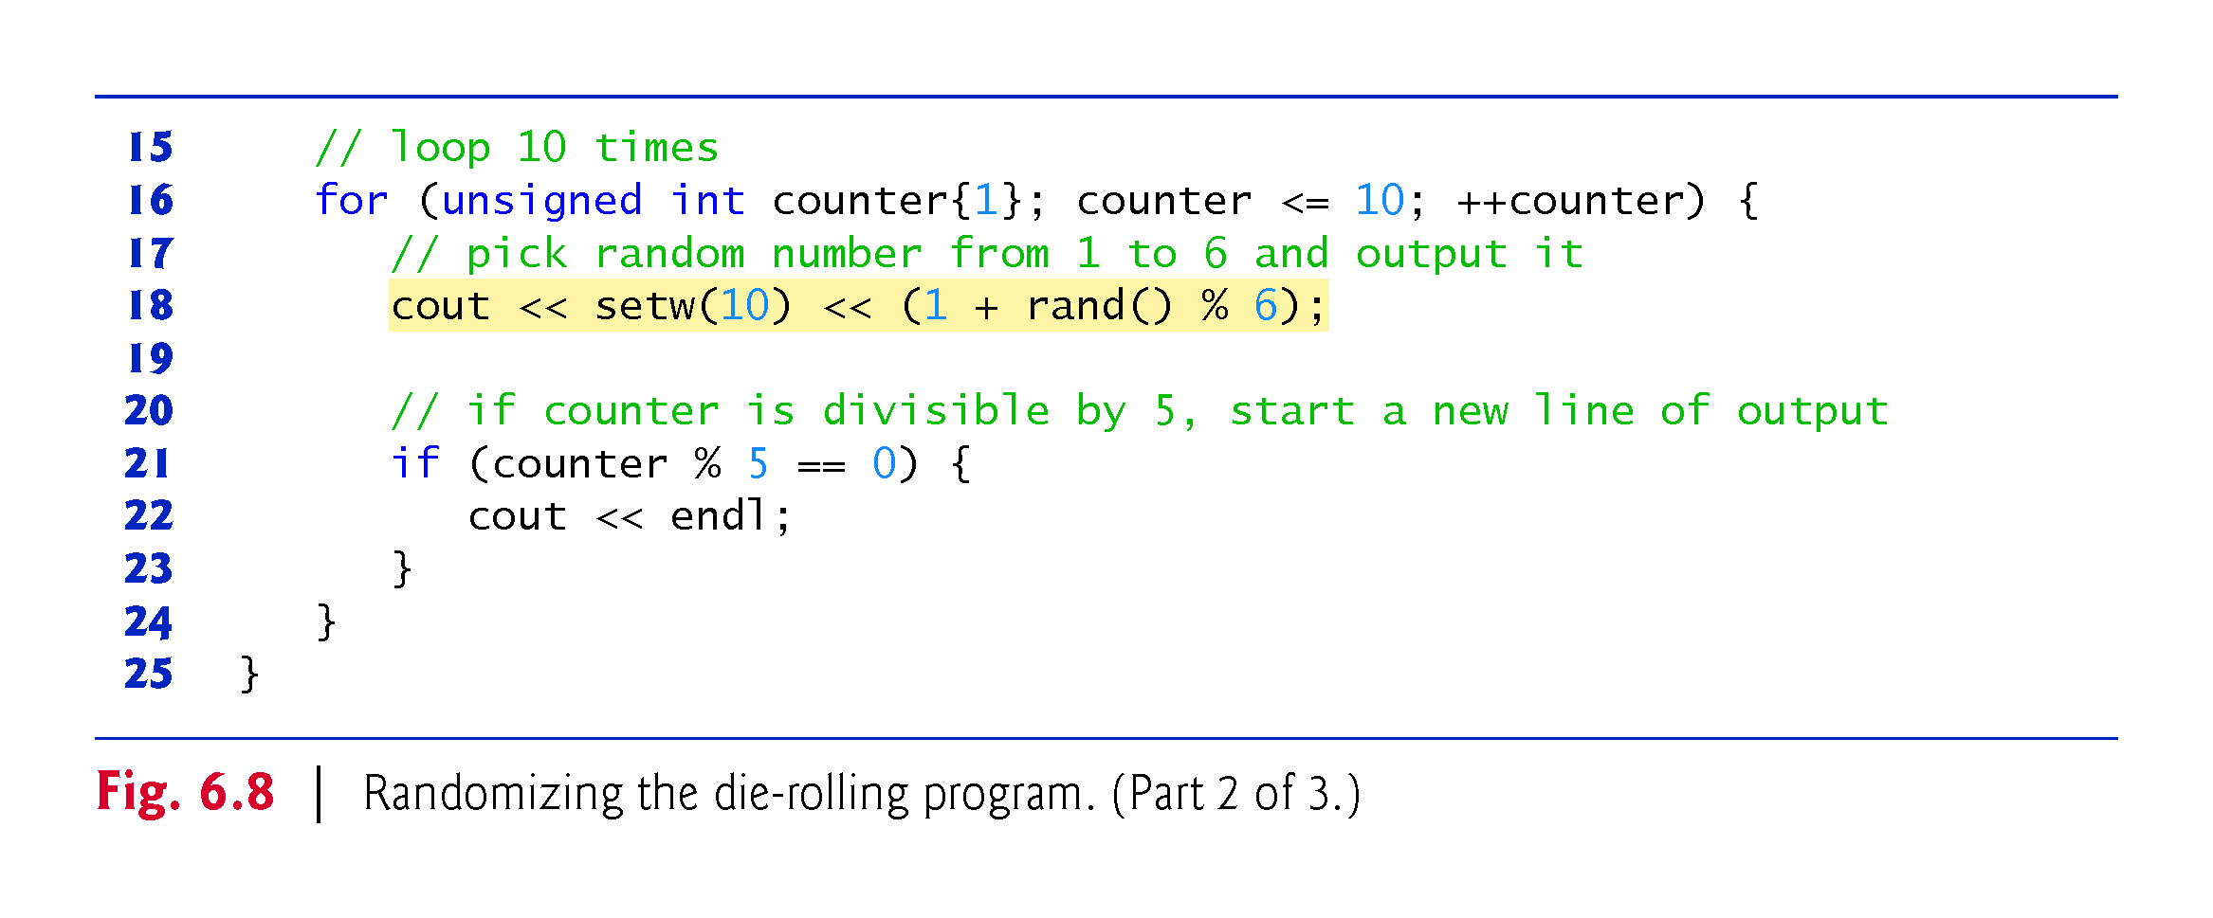
©1992-2017 by Pearson Education, Inc. All Rights Reserved.

Slide 69
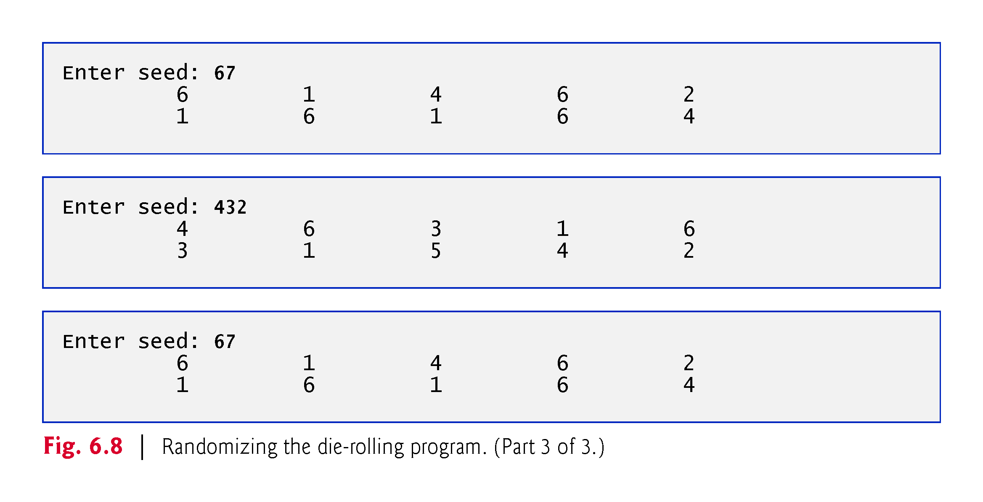
©1992-2017 by Pearson Education, Inc. All Rights Reserved.

Slide 70
6.7.4 Seeding the Random-Number Generator with the Current Time
To randomize without having to enter a seed
srand(static_cast<unsigned int>(time(0)));
Causes the computer to read its clock to obtain the value for the seed.
Function time (with the argument 0 as written in the preceding statement) returns the current time as the number of seconds since January 1, 1970, at midnight Greenwich Mean Time (GMT).
The function prototype for time is in <ctime>.
©1992-2017 by Pearson Education, Inc. All Rights Reserved.

Slide 71
6.7.5 Scaling and Shifting Random Numbers
To produce random numbers in a specific range use:
type variableName = shiftingValue + rand() % scalingFactor;
shiftingValue is equal to the first number in the desired range of consecutive integers
scalingFactor is equal to the width of the de-sired range of consecutive integers.
©1992-2017 by Pearson Education, Inc. All Rights Reserved.

Slide 72
6.8 Case Study: Game of Chance; Introducing enum
Rules of Craps
A player rolls two dice. Each die has six faces.
Faces contain 1, 2, 3, 4, 5 and 6 spots.
After the dice have come to rest, the sum of the spots on the two upward faces is calculated.
If the sum is 7 or 11 on the first roll, the player wins.
If the sum is 2, 3 or 12 on the first roll (called “craps”), the player loses (i.e., the “house” wins).
If the sum is 4, 5, 6, 8, 9 or 10 on the first roll, then that sum becomes the player’s “point.”
To win, continue rolling until you “make your point.”
You lose by rolling a 7 before making the point.
The program in Fig. 6.9 simulates the game.
©1992-2017 by Pearson Education, Inc. All Rights Reserved.

Slide 73
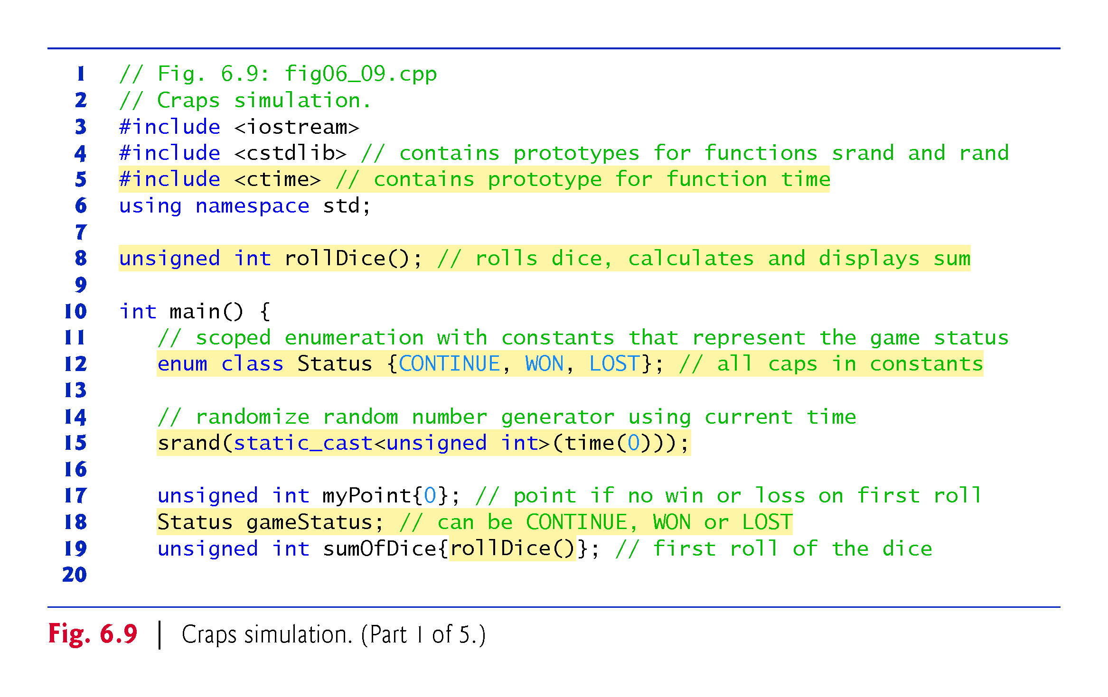
©1992-2017 by Pearson Education, Inc. All Rights Reserved.

Slide 74
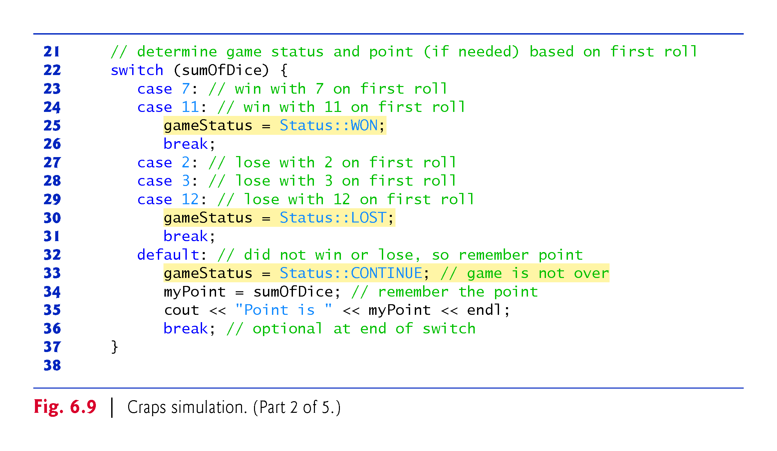
©1992-2017 by Pearson Education, Inc. All Rights Reserved.

Slide 75
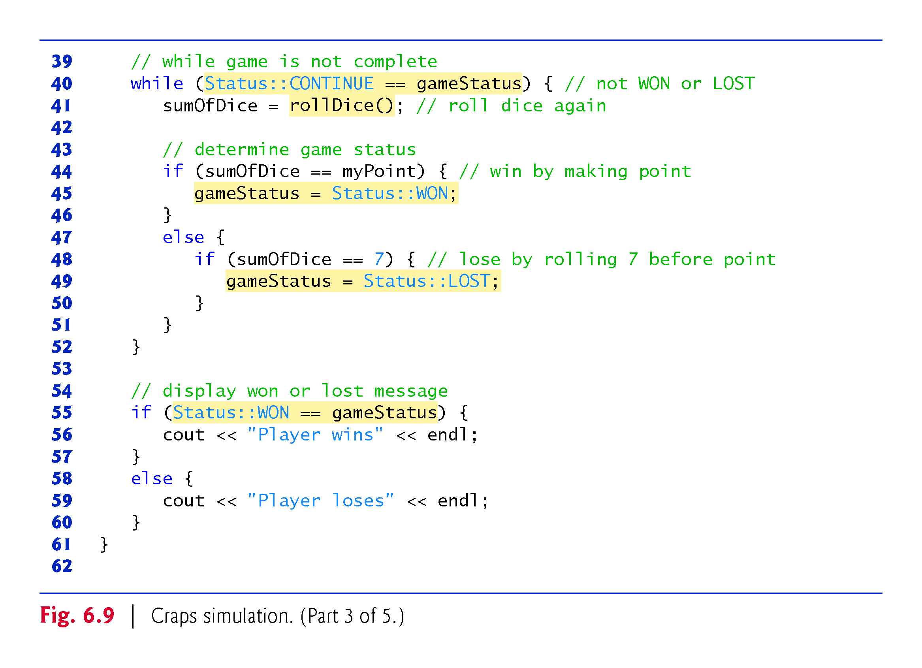
©1992-2017 by Pearson Education, Inc. All Rights Reserved.

Slide 76
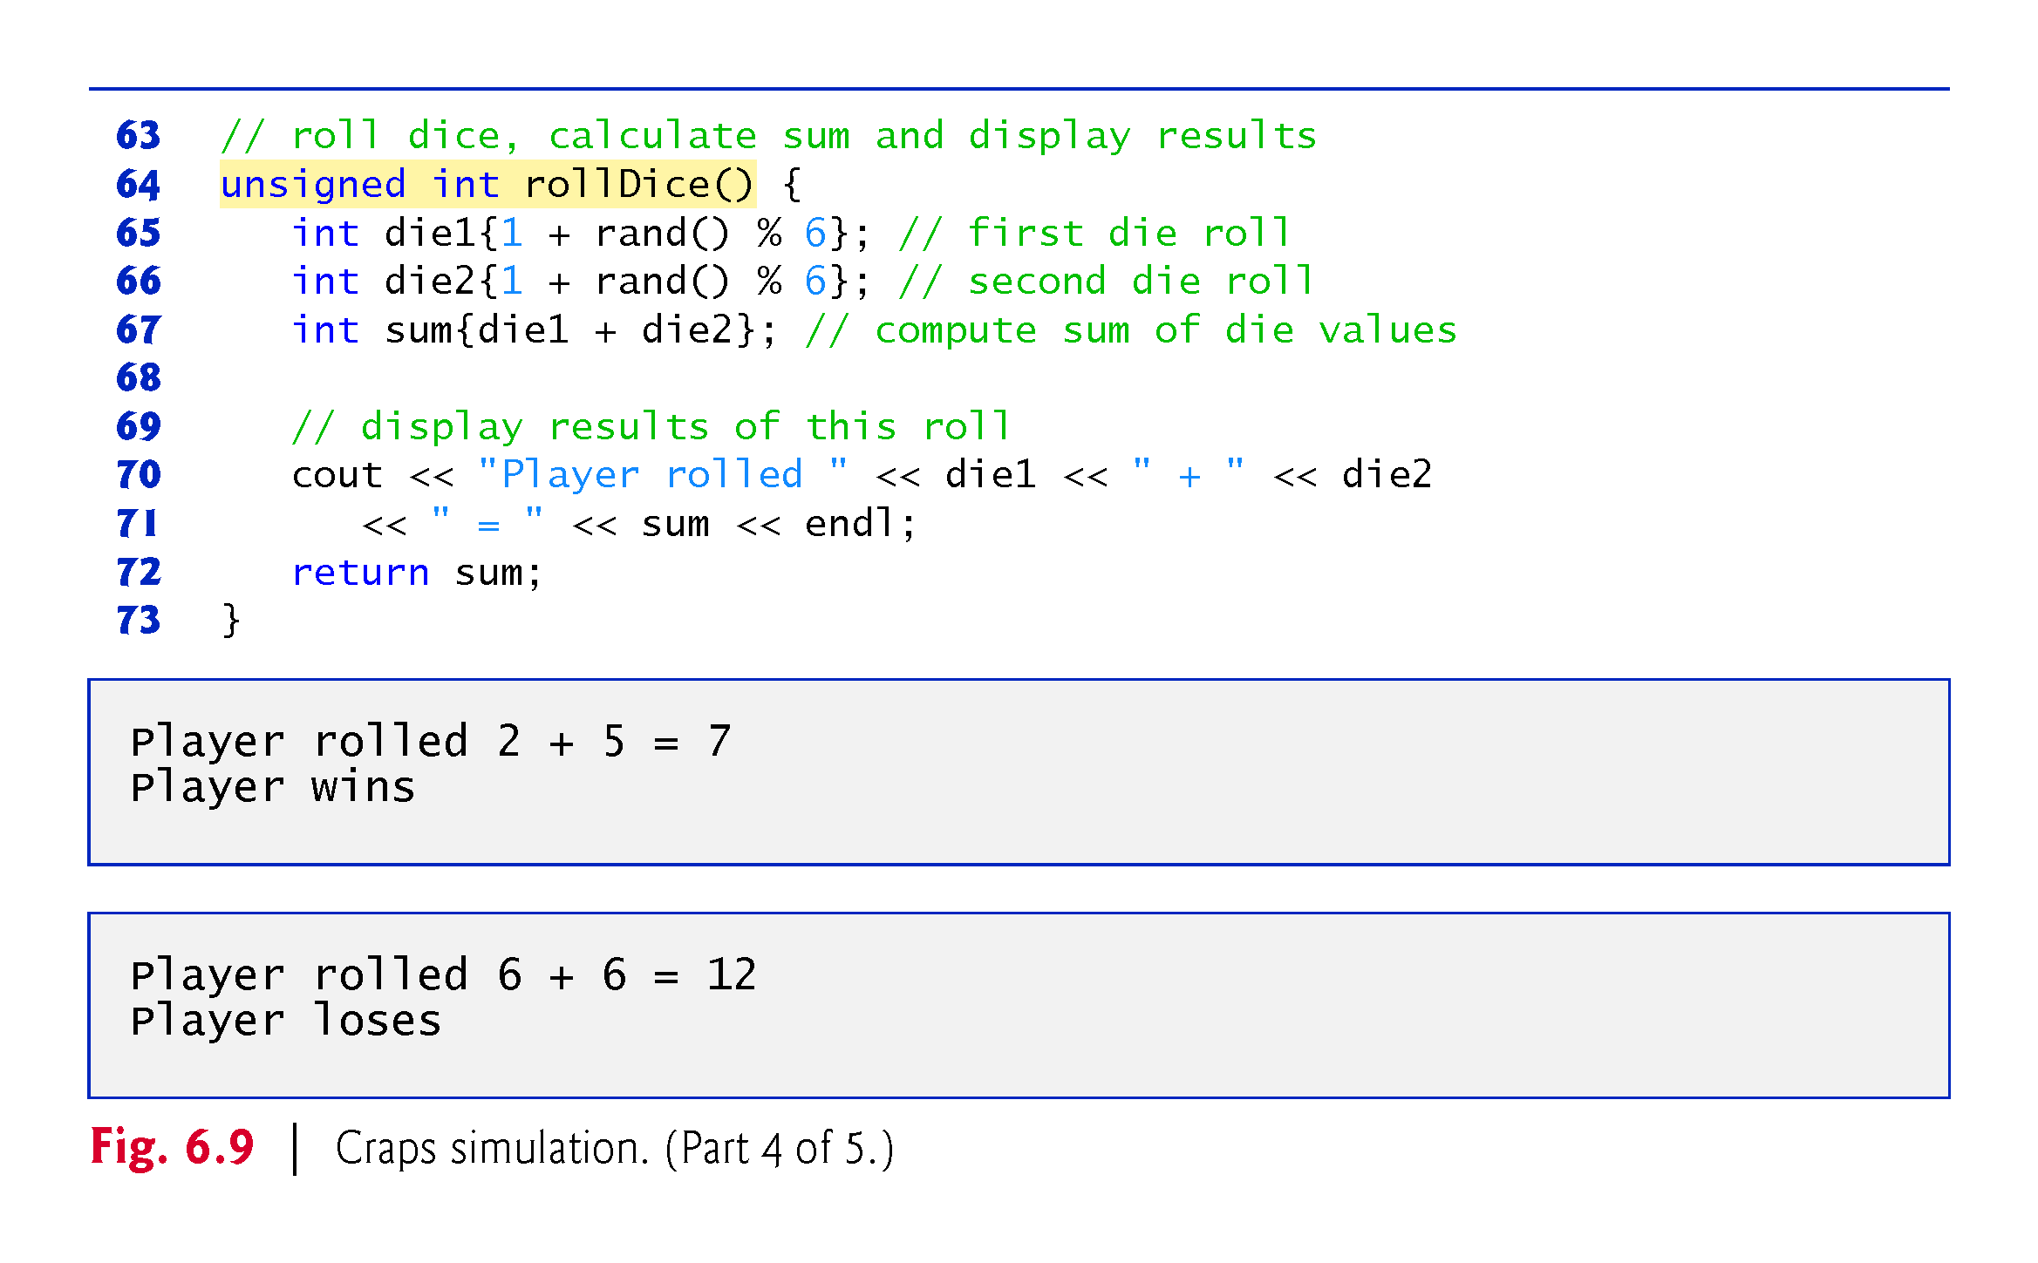
©1992-2017 by Pearson Education, Inc. All Rights Reserved.

Slide 77
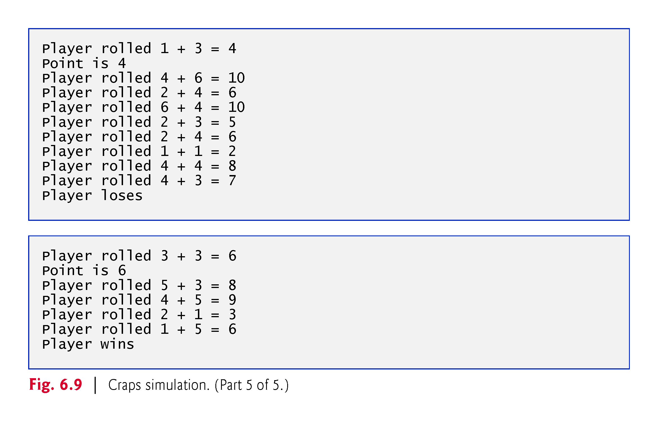
©1992-2017 by Pearson Education, Inc. All Rights Reserved.

Slide 78
6.8 Case Study: Game of Chance; Introducing enum (cont.)
A scoped enumeration (C++11) introduced by enum class and followed by a type name, is a set of identifiers representing integer constants.
The values of these enumeration constants start at 0, unless specified otherwise, and increment by 1.
The identifiers must be unique, but separate enumeration constants can have the same value.
Variables of an enum class can be assigned only one of the values declared in the enumeration.
©1992-2017 by Pearson Education, Inc. All Rights Reserved.

Slide 79
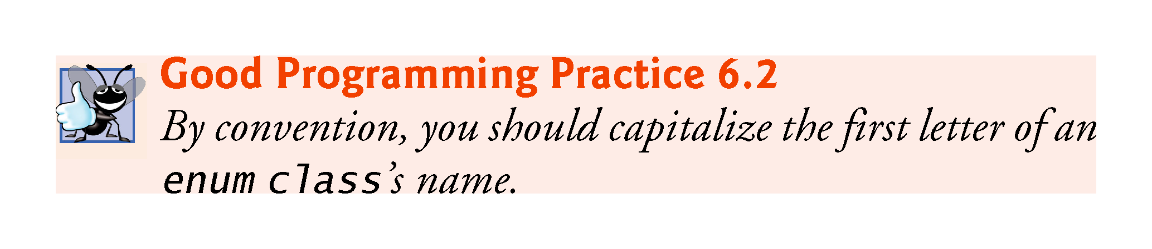
©1992-2017 by Pearson Education, Inc. All Rights Reserved.

Slide 80
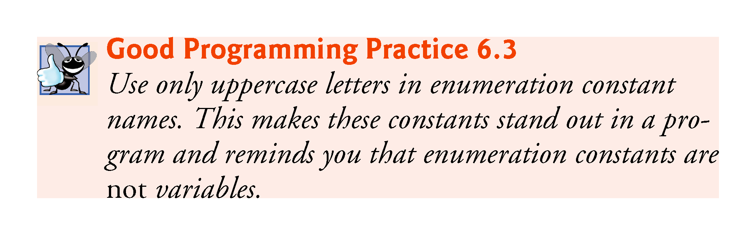
©1992-2017 by Pearson Education, Inc. All Rights Reserved.

Slide 81
6.8 Case Study: Game of Chance; Introducing enum (cont.)
To reference a scoped enum constant, qualify it with the type name and the scope-resolution operator (::), as in Status::CONTINUE.
©1992-2017 by Pearson Education, Inc. All Rights Reserved.

Slide 82
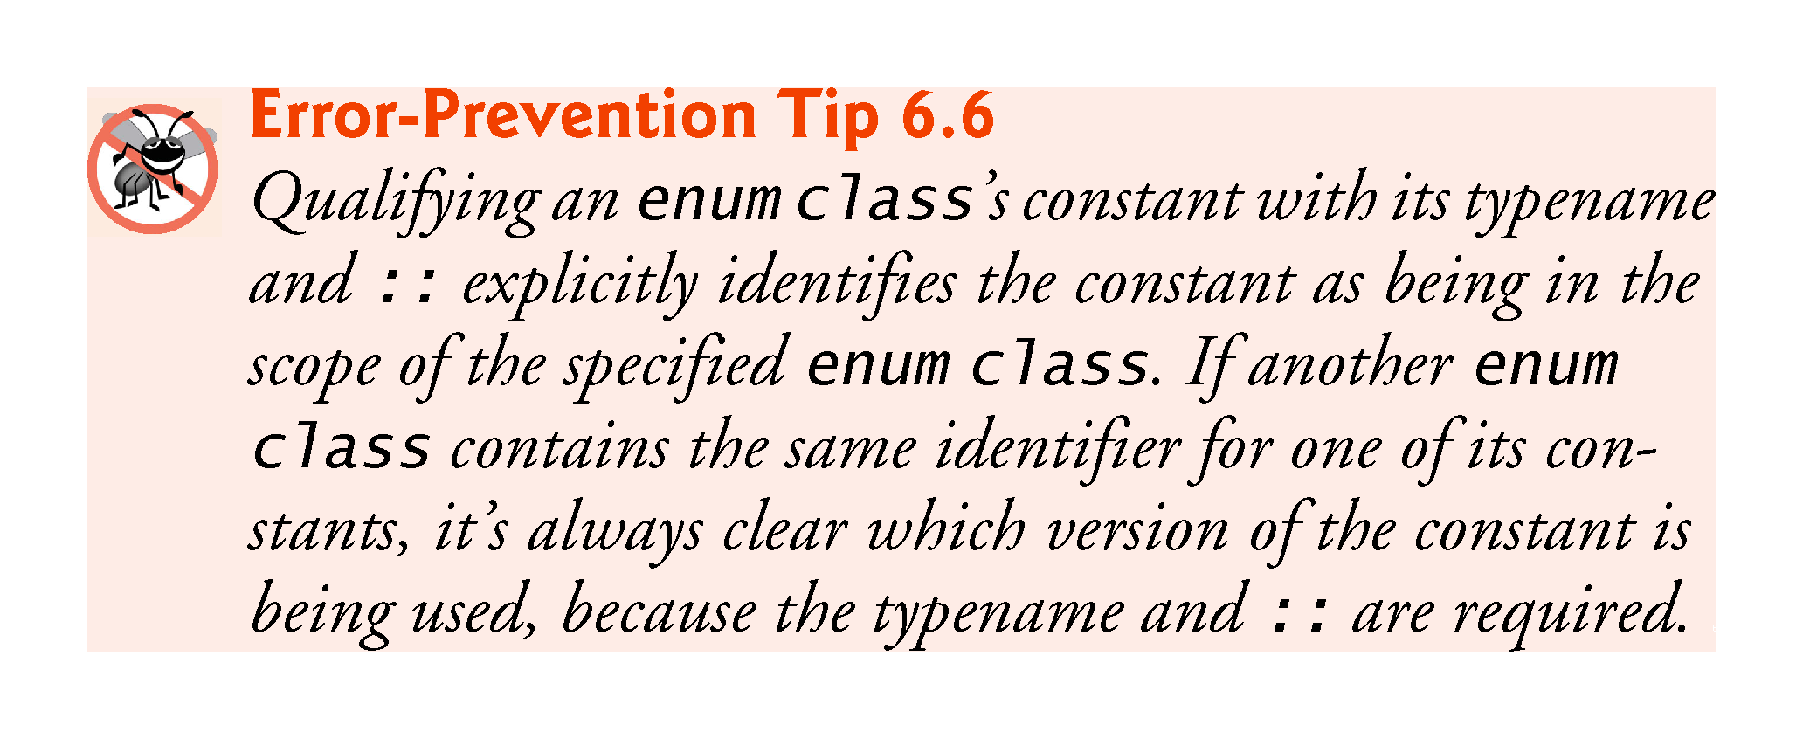
©1992-2017 by Pearson Education, Inc. All Rights Reserved.

Slide 83
6.8 Case Study: Game of Chance; Introducing enum (cont.)
Another popular enumeration is
enum class Months { JAN = 1, FEB, MAR, APR, MAY, JUN, JUL, AUG, SEP, OCT, NOV, DEC };
creates user-defined type Months with enumeration constants representing the months of the year.
The first value in the preceding enumeration is explicitly set to 1, so the remaining values increment from 1, resulting in the values 1 through 12.
Any enumeration constant can be assigned an integer value in the enumeration definition.
©1992-2017 by Pearson Education, Inc. All Rights Reserved.

Slide 84
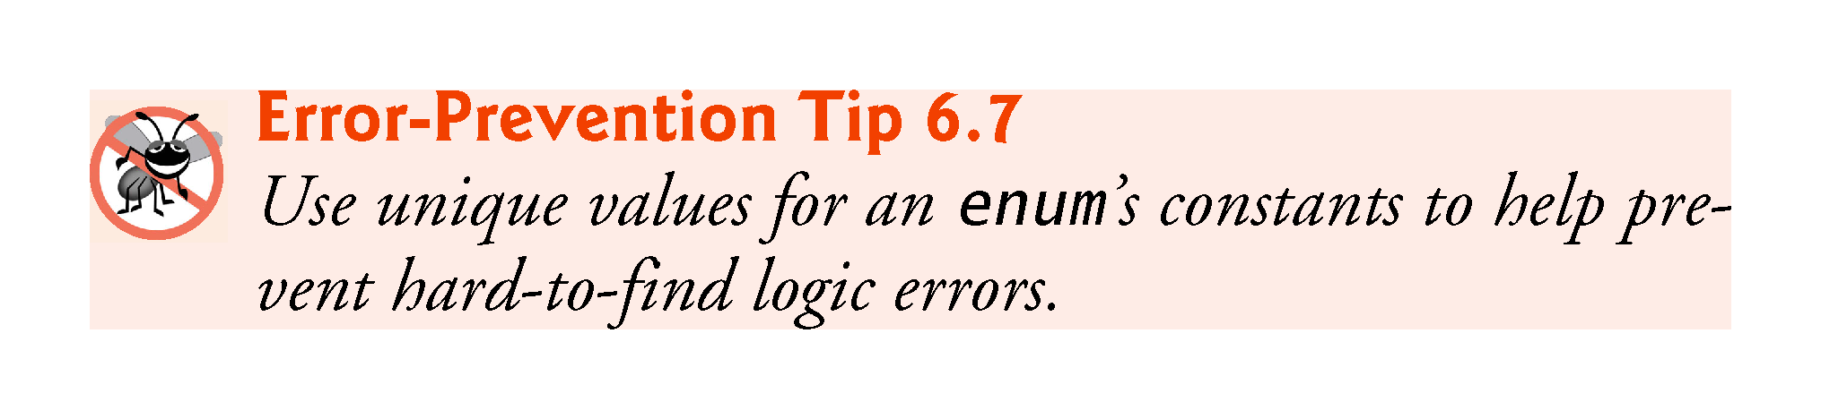
©1992-2017 by Pearson Education, Inc. All Rights Reserved.

Slide 85
6.8 Case Study: Game of Chance; Introducing enum (cont.)
Prior to C++11, enumerations were defined with enum (unscoped enums)
Problem: multiple enums may contain the same identifiers.
Using such enums in the same program can lead to naming collisions and logic errors.
©1992-2017 by Pearson Education, Inc. All Rights Reserved.

Slide 86
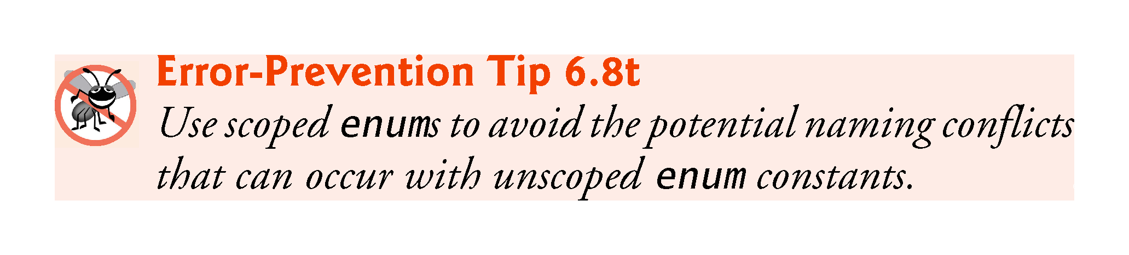
©1992-2017 by Pearson Education, Inc. All Rights Reserved.

Slide 87
6.8 Case Study: Game of Chance; Introducing enum (cont.)
Enumeration constants are represented as integers.
An unscoped enum’s underlying integral type depends on its constants’ values—the type is guaranteed to be large enough to store the constant values specified.
A scoped enum’s underlying integral type is int.
You to specify a scoped enum’s underlying integral type by following the enum’s type name with a colon (:) and the integral type.
We can specify that the constants in the enum class Status should have type unsigned int, as in
enum class Status : unsigned int {CONTINUE, WON, LOST};
©1992-2017 by Pearson Education, Inc. All Rights Reserved.

Slide 88
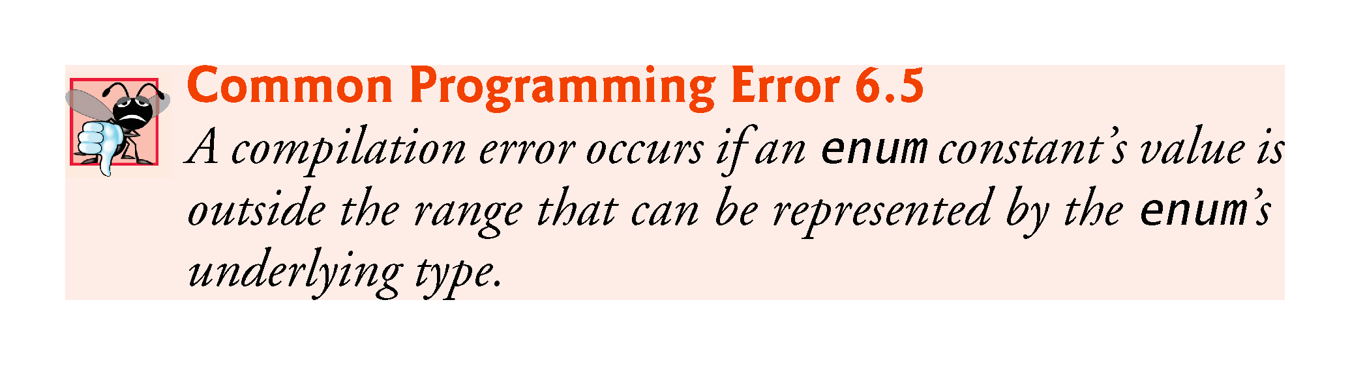
©1992-2017 by Pearson Education, Inc. All Rights Reserved.

Slide 89
6.9 C++11 Random Numbers
According to CERT, function rand does not have “good statistical properties” and can be predictable, which makes programs that use rand less secure (CERT guideline MSC30-CPP).
C++11 provides a new, more secure library of random-number capabilities that can produce nondeterministic random numbers that can’t be predicted.
Such random-number generators are used in simulations and security scenarios where predictability is undesirable.
New capabilities are located in the C++ Standard Library’s <random> header.
©1992-2017 by Pearson Education, Inc. All Rights Reserved.

Slide 90
6.9 C++11 Random Numbers (cont.)
For flexibility based on how random numbers are used in programs, C++11 provides many classes that represent various random-number generation engines and distributions.
An engine implements a random-number generation algorithm that produce pseudorandom numbers.
A distribution controls the range of values produced by an engine, the types of those values (e.g., int, double, etc.) and the statistical properties of the values.
uniform_int_distribution evenly distributes pseudorandom integers over a specified range of values.
©1992-2017 by Pearson Education, Inc. All Rights Reserved.

Slide 91
6.9 C++11 Random Numbers (cont.)
Rolling a Six-Sided Die
Figure 6.10 uses the default_random_engine and the uniform_int_distribution to roll a six-sided die.
default_random_engine object named engine.
Its constructor argument seeds the random-number generation engine with the current time.
If you don’t pass a value to the constructor, the default seed will be used and the program will produce the same sequence of numbers each time it executes.
randomInt—a uniform_int_distribution object that produces unsigned int values (as specified by <unsigned int>) in the range 1 to 6 (as specified by the constructor arguments).
The expression randomInt(engine) returns one unsigned int value in the range 1 to 6.
©1992-2017 by Pearson Education, Inc. All Rights Reserved.

Slide 92
6.9 C++11 Random Numbers (cont.)
The notation <unsigned int> indicates that uniform_int_distribution is a class template.
In this case, any integer type can be specified in the angle brackets (< and >).
In Chapter 18, we discuss how to create class templates and various other chapters show how to use existing class templates from the C++ Standard Library.
For now, you should feel comfortable using class template uniform_int_distribution by mimicking the syntax shown in the example.
©1992-2017 by Pearson Education, Inc. All Rights Reserved.

Slide 93
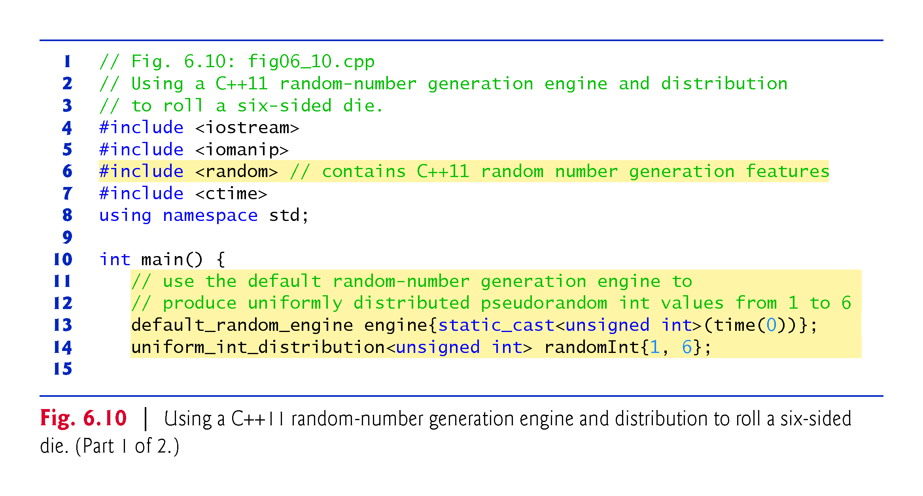
©1992-2017 by Pearson Education, Inc. All Rights Reserved.

Slide 94
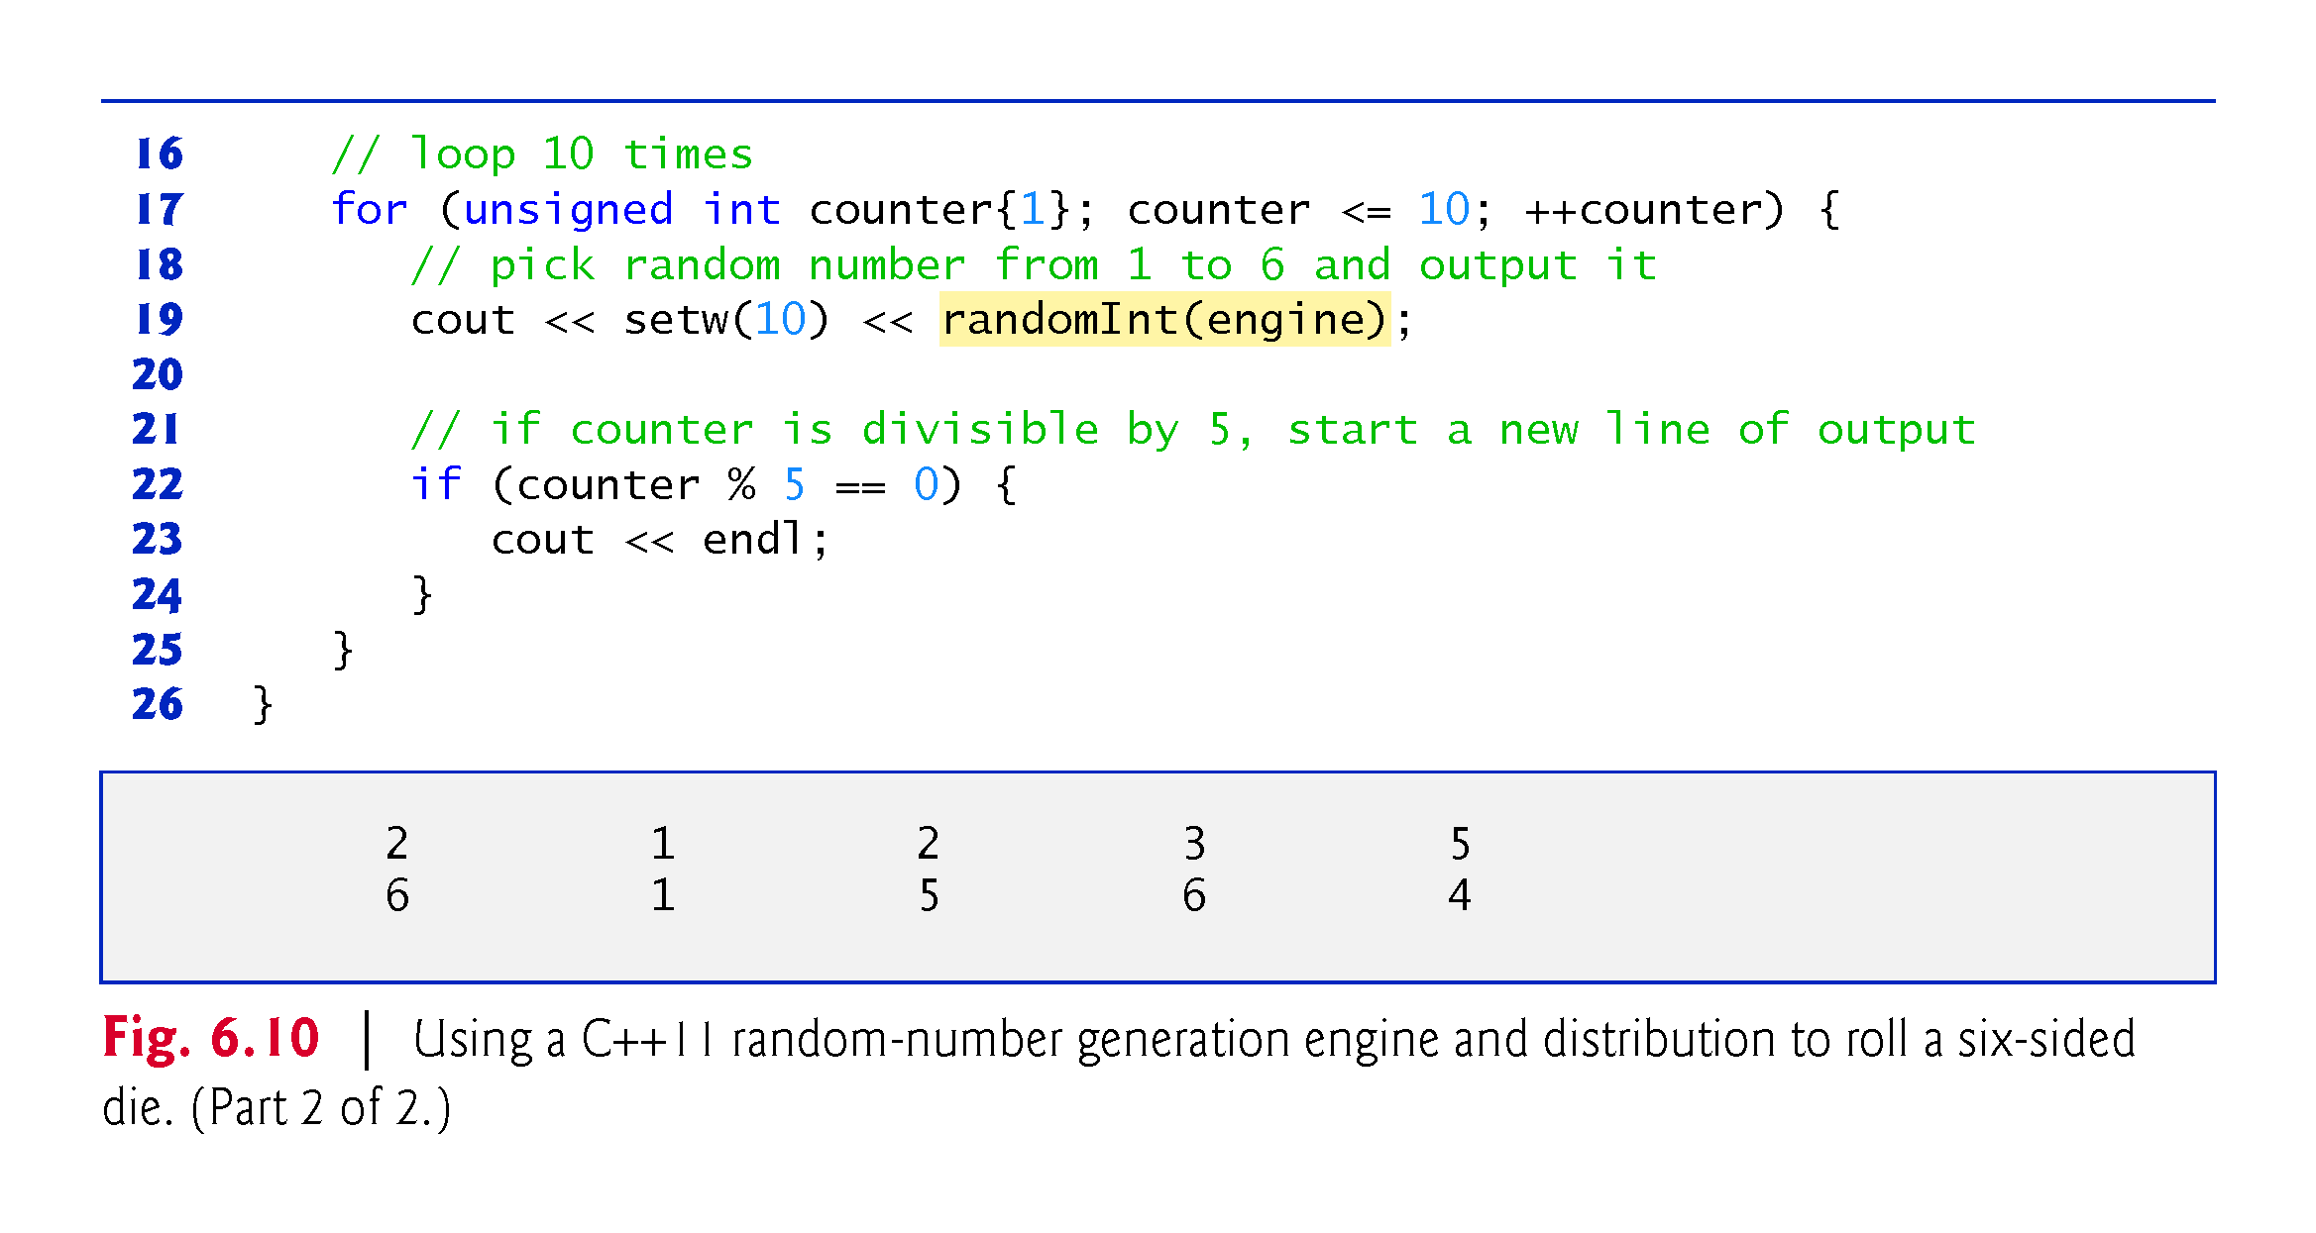
©1992-2017 by Pearson Education, Inc. All Rights Reserved.

Slide 95
Exercise
Write a program that asks for an integer “seed” and prints 20 random integers with that seed. Use srand(seed) and rand() to generate the numbers. Try with different values of seed.
Modify the program so that the values are between 0 and 9.
Modify the program so that the values are between 5 and 10.
©1992-2017 by Pearson Education, Inc. All Rights Reserved.

Slide 96
6.11 Function Call Stack and Activation Records
To understand how C++ performs function calls, we first need to consider a data structure (i.e., collection of related data items) known as a stack.
Analogous to a pile of dishes.
When a dish is placed on the pile, it’s normally placed at the top—referred to as pushing.
Similarly, when a dish is removed from the pile, it’s normally removed from the top—referred to as popping.
Last-in, first-out (LIFO) data structures—the last item pushed (inserted) is the first item popped (removed).
©1992-2017 by Pearson Education, Inc. All Rights Reserved.

Slide 97
6.11 Function Call Stack and Activation Records (cont.)
Function-Call Stack
One of the most important mechanisms for computer science students to understand is the function call stack (or program execution stack).
supports the function call/return mechanism.
Also supports the creation, maintenance and destruction of each called function’s automatic variables.
©1992-2017 by Pearson Education, Inc. All Rights Reserved.

Slide 98
6.11 Function Call Stack and Activation Records (cont.)
Stack Frames
Each function eventually must return control to the function that called it.
Each time a function calls another function, an entry is pushed onto the function call stack.
This entry, called a stack frame or an activation record, contains the return address that the called function needs in order to return to the calling function.
©1992-2017 by Pearson Education, Inc. All Rights Reserved.

Slide 99
6.11 Function Call Stack and Activation Records (cont.)
Automatic Local Variables and Stack Frames
When a function call returns, the stack frame for the function call is popped, and control transfers to the return address in the popped stack frame.
Stack Overflow
The amount of memory in a computer is finite, so only a certain amount of memory can be used to store activation records on the function call stack.
If more function calls occur than can have their activation records stored on the function call stack, an a fatal error known as stack overflow occurs.
©1992-2017 by Pearson Education, Inc. All Rights Reserved.

Slide 100
6.11 Function Call Stack and Activation Records (cont.)
Function Call Stack in Action
Now let’s consider how the call stack supports the operation of a square function called by main (Fig. 6.12).
First the operating system calls main—this pushes an activation record onto the stack (shown in Fig. 6.13).
The activation record tells main how to return to the operating system (i.e., transfer to return address R1) and contains the space for main’s automatic variable (i.e., a, which is initialized to 10).
©1992-2017 by Pearson Education, Inc. All Rights Reserved.

Slide 101

©1992-2017 by Pearson Education, Inc. All Rights Reserved.

Slide 102

©1992-2017 by Pearson Education, Inc. All Rights Reserved.

Slide 103
6.12 Function Call Stack and Activation Records (cont.)
Function main—before returning to the operating system—now calls function square in line 12 of Fig. 6.12.
This causes a stack frame for square (lines 16–18) to be pushed onto the function call stack (Fig. 6.14).
This stack frame contains the return address that square needs to return to main (i.e., R2) and the memory for square’s automatic variable (i.e., x).
©1992-2017 by Pearson Education, Inc. All Rights Reserved.

Slide 104

©1992-2017 by Pearson Education, Inc. All Rights Reserved.

Slide 105
6.12 Function Call Stack and Activation Records (cont.)
After square calculates the square of its argument, it needs to return to main—and no longer needs the memory for its automatic variable x. So square’s stack frame is popped from the stack—giving square the return location in main (i.e., R2) and losing square’s automatic variable.
Figure 6.15 shows the function call stack after square’s activation record has been popped.
©1992-2017 by Pearson Education, Inc. All Rights Reserved.

Slide 106

©1992-2017 by Pearson Education, Inc. All Rights Reserved.

Slide 107
6.13 References and Reference Parameters
Two ways to pass arguments to functions in many programming languages are pass-by-value and pass-by-reference.
When an argument is passed by value, a copy of the argument’s value is made and passed (on the function call stack) to the called function.
Changes to the copy do not affect the original variable’s value in the caller.
To specify a reference to a constant, place the const qualifier before the type specifier in the parameter declaration.
©1992-2017 by Pearson Education, Inc. All Rights Reserved.

Slide 108

©1992-2017 by Pearson Education, Inc. All Rights Reserved.

Slide 109
6.15 References and Reference Parameters (cont.)
With pass-by-reference, the caller gives the called function the ability to access the caller’s data directly, and to modify that data.
A reference parameter is an alias for its corresponding argument in a function call.
To indicate that a function parameter is passed by reference, simply follow the parameter’s type in the function prototype by an ampersand (&); use the same convention when listing the parameter’s type in the function header.
Figure 6.17 compares pass-by-value and pass-by-reference with reference parameters.
©1992-2017 by Pearson Education, Inc. All Rights Reserved.

Slide 110

©1992-2017 by Pearson Education, Inc. All Rights Reserved.

Slide 111

©1992-2017 by Pearson Education, Inc. All Rights Reserved.

Slide 112

©1992-2017 by Pearson Education, Inc. All Rights Reserved.

Slide 113

©1992-2017 by Pearson Education, Inc. All Rights Reserved.

Slide 114

©1992-2017 by Pearson Education, Inc. All Rights Reserved.

Slide 115
6.15 References and Reference Parameters (cont.)
References can also be used as aliases for other variables within a function.
Reference variables must be initialized in their declarations and cannot be reassigned as aliases to other variables.
Once a reference is declared as an alias for another variable, all operations supposedly performed on the alias are actually performed on the original variable.
©1992-2017 by Pearson Education, Inc. All Rights Reserved.

Slide 116
6.14 Default Arguments
It common for a program to invoke a function repeatedly with the same argument value for a particular parameter.
Can specify that such a parameter has a default argument, i.e., a default value to be passed to that parameter.
When a program omits an argument for a parameter with a default argument in a function call, the compiler rewrites the function call and inserts the default value of that argument.
Figure 6.18 demonstrates using default arguments to calculate a box’s volume.
©1992-2017 by Pearson Education, Inc. All Rights Reserved.

Slide 117

©1992-2017 by Pearson Education, Inc. All Rights Reserved.

Slide 118

©1992-2017 by Pearson Education, Inc. All Rights Reserved.

Slide 119
6.14 Default Arguments
Default arguments must be the rightmost (trailing) arguments in a function’s parameter list.
When calling a function with two or more default arguments, if an omitted argument is not the rightmost argument, then all arguments to the right of that argument also must be omitted.
Default arguments must be specified with the first occurrence of the function name—typically, in the function prototype.
Default values can be any expression, including constants, global variables or function calls. Default arguments also can be used with inline functions.
©1992-2017 by Pearson Education, Inc. All Rights Reserved.

Slide 120

©1992-2017 by Pearson Education, Inc. All Rights Reserved.

Slide 121
6.15 Unary Scope Resolution Operator
C++ provides the unary scope resolution operator (::) to access a global variable when a local variable of the same name is in scope.
Using the unary scope resolution operator (::) with a given variable name is optional when the only variable with that name is a global variable.
Figure 6.19 shows the unary scope resolution operator with local and global variables of the same name.
©1992-2017 by Pearson Education, Inc. All Rights Reserved.

Slide 122

©1992-2017 by Pearson Education, Inc. All Rights Reserved.

Slide 123

©1992-2017 by Pearson Education, Inc. All Rights Reserved.

Slide 124

©1992-2017 by Pearson Education, Inc. All Rights Reserved.

Slide 125

©1992-2017 by Pearson Education, Inc. All Rights Reserved.

Slide 126

©1992-2017 by Pearson Education, Inc. All Rights Reserved.

Slide 127
6.16 Function Overloading
C++ enables several functions of the same name to be defined, as long as they have different signatures.
This is called function overloading.
The C++ compiler selects the proper function to call by examining the number, types and order of the arguments in the call.
Function overloading is used to create several functions of the same name that perform similar tasks, but on different data types.
©1992-2017 by Pearson Education, Inc. All Rights Reserved.

Slide 128

©1992-2017 by Pearson Education, Inc. All Rights Reserved.

Slide 129
6.16 Function Overloading (cont.)
Figure 6.20 uses overloaded square functions to calculate the square of an int and the square of a double.
©1992-2017 by Pearson Education, Inc. All Rights Reserved.

Slide 130

©1992-2017 by Pearson Education, Inc. All Rights Reserved.

Slide 131

©1992-2017 by Pearson Education, Inc. All Rights Reserved.

Slide 132
6.16 Function Overloading (cont.)
How the Compiler Differentiates Among Overloaded Functions
Overloaded functions are distinguished by their signatures.
A signature is a combination of a function’s name and its parameter types (in order).
The compiler encodes each function identifier with the types of its parameters (sometimes referred to as name mangling or name decoration) to enable type-safe linkage.
Ensures that the proper overloaded function is called and that the types of the arguments conform to the types of the parameters.
Figure 6.21 was compiled with GNU C++.
Rather than showing the execution output of the program, we show the mangled function names produced in assembly language by GNU C++.
©1992-2017 by Pearson Education, Inc. All Rights Reserved.

Slide 133

©1992-2017 by Pearson Education, Inc. All Rights Reserved.

Slide 134

©1992-2017 by Pearson Education, Inc. All Rights Reserved.

Slide 135
6.16 Function Overloading (cont.)
For GNU C++, each mangled name (other than main) begins with two underscores (__) followed by the letter Z, a number and the function name.
The number specifies how many characters are in the function’s name.
The compiler distinguishes the two square functions by their parameter lists—one specifies i for int and the other d for double.
The return types of the functions are not specified in the mangled names.
Overloaded functions can have different return types, but if they do, they must also have different parameter lists.
Function-name mangling is compiler specific.
©1992-2017 by Pearson Education, Inc. All Rights Reserved.

Slide 136

©1992-2017 by Pearson Education, Inc. All Rights Reserved.

